Slide 1

South Pacific Division
Southern California Earthquake Response Plan
Amy Aton
Readiness and Contingency Operations
South Pacific Division
30 Apr 2014

Slide 2
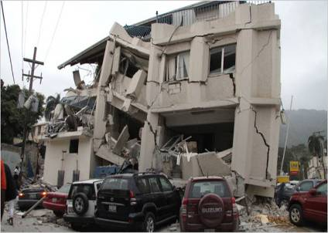
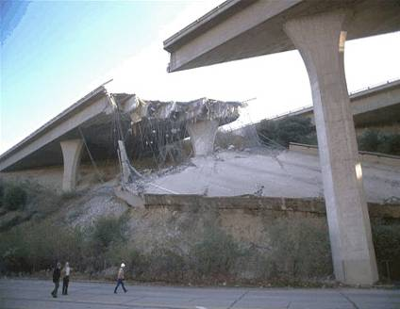
Southern California Catastrophic Earthquake Response Plan
Scenario
Situation
Assumption
Impacts
Activation
Response Framework
Critical Areas of Concern
Bundled PSMA
Mission Specifics
Notes:
2
2
Purpose / Agenda for today’s forum.
Set the Stage:
Introduce the Leadership Team
Common Regional Picture (CRP)
Emergency Response
Campaign Plan/IPLAN/OPLAN Journey
Focus of Our Time:
Key Topics – Military Housing, Tricare Remote, Cost of Living Adjustment, STRATCOM, Civilian Appraisals, Congressional Interface, End of Year Execution
Battle Rhythm
Conclude:
Way Ahead
Open Discussion with Incoming Command Teams
NEXT SLIDE PLEASE
https://www.youtube.com/watch?v=ixVVuN-mF1M 0000-01:33, 2:35-3:16

Slide 3
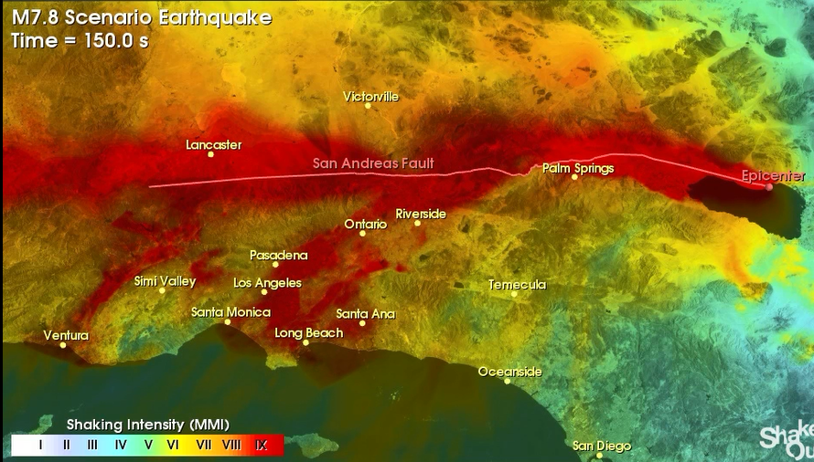
San Andreas Fault Eruption in So Cal
Southern California Catastrophic Earthquake

Slide 4

Ground Motion

Slide 5

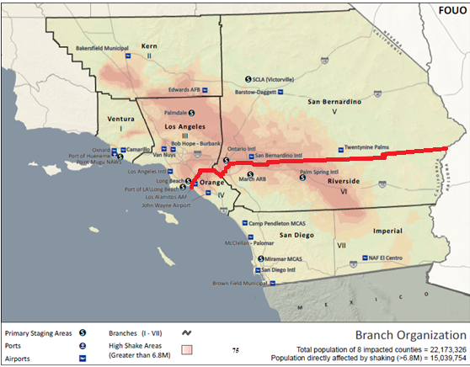
Cajon Pass
Situation
Magnitude 7.8 earthquake on the southernmost segment of the San Andreas Fault impacting 8 counties in Southern California: Imperial, Kern, Los Angeles, Orange, Riverside, San Bernardino, San Diego, and Ventura
.General Impacts
Displaces 542,000 people (10% toddlers/infants)
Over 35,000 people requiring Urban Search and Rescue
Requires 255,000 shelters
1,800 dead, 53,000 injured.
Surface ruptures at I-10 and I-15 fault crossings
Damage triggers evacuations at dams
300,000 buildings (many high-rises) significantly damaged
1,600 expected fires
3-30 inch natural gas lines will rupture
Food and water for 2.5 million people sheltering in place
Credible threat of collapse of pre-1994 steel frame high rises
81 Million tons of debris
Landfills will be over capacity and other debris options are required
Sewer pipelines and equipment at water/waste water treatment plants will be damaged
30 dams within ~15 miles of fault could experience damage
Aqueduct and levee failures will flood neighborhoods and reduces water flow to City of Los Angeles
N/W EM Power ISB
Incoming Responders
FEMA RSOI
Water Conveyance
S
S
Cajon Pass
S
S
S
S
S
S
S/E EM Power ISB
Port Reconstruction
S
2
Notes:
2.5 million people will shelter in place and will require food and water
One nuclear power site (San Clemente) will shut down
Loss of communication, water, electricity, and fuel and supporting infrastructure
Three 30-inch natural gas lines will rupture
Significant damage to communication, electrical, fuel and rail lines at Cajon Pass
Utilities will not be restored quickly and there will be long term recovery
Airport capability in the region is significantly impacted
Loss of Power, damage to in/egress roads/rail and water debris will render Ports unusable
LA and Long Beach ports are the major ports of supply for the western United States and Hawaii
Restoration of Ports are of National Importance
Railroad lines at 21 locations along the San Andreas fault will be greatly affected
The road network throughout the region is severely impacted
81 million tons of debris will be generated and require removal
Landfills will be over capacity and other debris options are required
Sewer pipelines and equipment at water/waste water treatment plants will be damaged
30 dams within ~15 miles of fault could experience damage
Aqueduct and levee failures will flood neighborhoods and reduces water flow to City of Los Angeles
Aftershocks will continue for months impacting or undoing response efforts

Slide 6
Assumptions
The California Governor will request and President will grant an Emergency Declaration
Southern California Earthquake will be a Level 1 Event due to National level impacts and severity of damage.
NRCC (under Level 1 Response) will immediately execute the USACE Southern California Earthquake Bundled Mission Assignment ($129.3M)
Los Angeles District will immediately execute their COOP
Los Angeles District office at 915 Wilshire Blvd unusable, reconstitution of district at alternate location
Sacramento District is task-assigned as lead supporting district, immediately executing response activities
<unknown>% of Los Angeles District personnel are available to respond
Victorville/Barstow is designated as primary staging area for incoming responders
FEMA has activated 10 US&R Task Forces requiring the entire USACE Structures Specialist Cadre (50 Pax) for sustained response
Responders must be self-sustaining for 72-96 hours
USACE Responding personnel/RSOI processing expectation in first 10 days
  0-72 hours: 314 responders (identified by launch bundle)
  4-7 days: : 721 responders (identified by launch bundle)
  7-10 days : 900+ responders (identified by launch bundle)
Notes:
USACE force deployments as identified in the Southern CA Earthquake Bundled Mission Assignment
Note: there will be fiscal constraint of the bundled PSMA of $129.3M. The tasking orders of the bundle define the scope of what will be deployed.
LEVEL 1 Event Criteria:
An incident of such magnitude that the available assets that were designed and pin in place for the response are completely overwhelmed or broken at the local, regional, or national level .
Due to its severity, size, location, actual or potential impact on public health, welfare, and infrastructure, it requires an extreme amount of federal assistance for response and recovery efforts for which the capability to support do not exist at any level.
A Level 1 Disaster requires extraordinary coordination among federal, state, tribal, and local entities due to massive levels and breadth of damage, severs impact or multi-state scope.
Major involvement of FEMA (full activation of RRCC and NRCC), other federal agencies (all ESFs) , and deployment of initial response resources are required to support requirements of the affected State.
National Guard aircraft are available for initial recon of impact area
NRCC (under Level 1 Response) will immediately execute the Department of Defense (DOD) Southern California Earthquake Bundled Mission Assignment

Slide 7
DAMAGE IMPACTS with USACE Roles
USACE mission assignment (bundle)
USACE TF/coordination
USACE Authorities
A magnitude 7.8 earthquake on the southernmost segment of the San Andreas Fault will impact 8 counties in Southern California: Imperial, Kern, Los Angeles, Orange, Riverside, San Bernardino, San Diego, and Ventura.
542,000 people will be displaced (10% will be toddlers and infants)
255,000 people will require shelters
53,000 people will be injured and will require medical services
1,800 people will be immediate mortalities and will require remains handling
267,000 household pets will be displaced
300,000 buildings (many high-rises) will be significantly damaged
1,600 fires are expected
2.5 million people will shelter in place and will require food and water
One nuclear power site (San Clemente) will shut down
Loss of communication, water, electricity, and fuel and supporting infrastructure
Three 30-inch natural gas lines will rupture
Significant damage to communication, electrical, fuel and rail lines at Cajon Pass
Utilities will not be restored quickly and there will be long term recovery
Airport capability in the region is significantly impacted
Loss of Power, damage to in/egress roads/rail and water debris will render Ports unusable
Restoration of Ports are of National Importance
Railroad lines at 21 locations along the San Andreas fault will be greatly affected
The road network throughout the region is severely impacted
81 million tons of debris will be generated and require removal. Landfills will be over capacity and other debris options are required
Sewer pipelines and equipment at water/waste water treatment plants will be damaged
30 dams within ~15 miles of fault could experience damage
Aqueduct and levee failures will flood neighborhoods and reduces water flow to City of Los Angeles
Loss of ability to transport power across the fault line (142 power lines cross fault)
Aftershocks will continue for months impacting or undoing response efforts

Slide 8
State of CA Coordinating Officer and Federal Coordinating Officers Incident Objectives
Crosswalk
with SPD Priorities
Conduct Search and Rescue Operations
Provide Safety, Security and Support to Emergency Response Operations
Reduce Hazards: Suppress Fire, Contain Hazardous Materials
Provide Emergency Health and Medical Services
Provide Mass Care support to include: care and shelter and support of evacuation operations and evacuees
Establish Lines of Supply for fuel/resources: Sea Ports, Airports, Railroads, and Roads
Conduct Mass Fatality Operations
Conduct Debris Clearance
Stabilize and augment critical utilities
Conduct Safety Assessments
Gain and Maintain Situational Awareness
Urban Search & Rescue Structures Specialist (Life Saving)
Accountability of SPD Personnel (Aftershocks)
Establish C2 & Common Operating Picture for vertical communication
Water and Bulk Water Acquisition & Delivery
Quickly establish EOC/RSOI to manage incoming assets
Debris Emergency Road Clearance
Emergency Power to Critical Public Facilities
Infrastructure Assessment & Water/Waste Water and Structural Technical Assistance

Slide 9
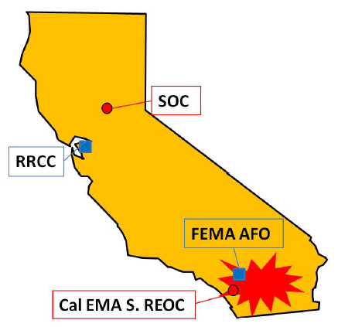


Activation / Deployment
0-24 Hrs
SOC and RRCC Activates begins assessment of Situation and Coordinate Response Activities
CalOES ROC and FEMA AFO Impacted by EQ
IMAT
UCG forms at SOC
24-72 Hrs
IMAT with OFAs Deploy to SOC
  Regional Augmentation
  Establish UCG
  Transitions to incident area (72hrs)
State/IMAT staff
  Establishes IOF in incident area at S.REOC or FEMA AFO
IMAT Staff
UCG
72hrs – 5 days
SOC and RRCC Maintain Level II Activation
  Maintain Situational Awareness
  Maintain Operational Awareness
State/IMAT w/ OFA
  Deploy to Operational Areas (AO) EOCs and establish Branches and Division
  JFO established to support 5000 responders
JFO

Slide 10
Response Framework
The earthquake will impact eight (8) counties in Southern California: Imperial County, Kern County, Los Angeles County, Orange County, Riverside County, San Bernardino County, San Diego County and Ventura County.
Los Angeles, Orange, Riverside, and San Bernardino Counties will be hardest hit. Branch Field Offices and corresponding USACE Emergency Field Offices (EFO) are part of the bundle PSMA
LGLs assigned to Branch Field Office
TL/ATL assigned to Branch Field Office

Slide 11
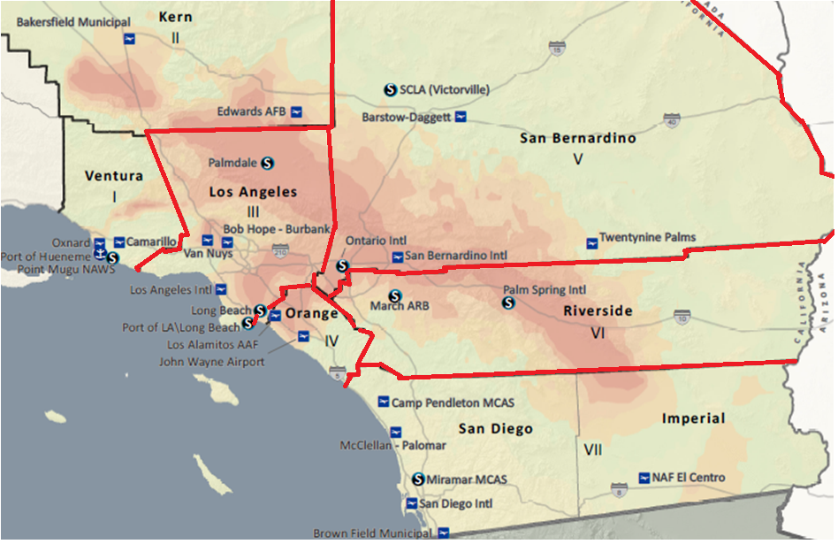
Forward Element Response
FEMA SoCal Area Field Office
JFO
Branches
  III - Los Angeles
  V – San Bernardino
  IV – Orange
  VI - Riverside
Southern REOC
Notes:
Federal forward elements of the FEMA IMAT, including DOD and selected ESFs establish an
IOF in coordination with the State at the Southern REOC at Los Alamitos or FEMA’s SoCal AFO located in Pasadena, CA. Depending o
Locate a JFO site and begins to equip the facility for 5,000 persons.
The SOC transitions to a support role when the UCG moves to the incident area and establishes command presence at the JFO.
The JFO is established and the UCG assumes operational control of the incident
The RRCC and SOC continue operations at Level II should aftershocks disrupt the UCG in the incident area
n survivability, either of these facilities can be used as IOFs

Slide 12
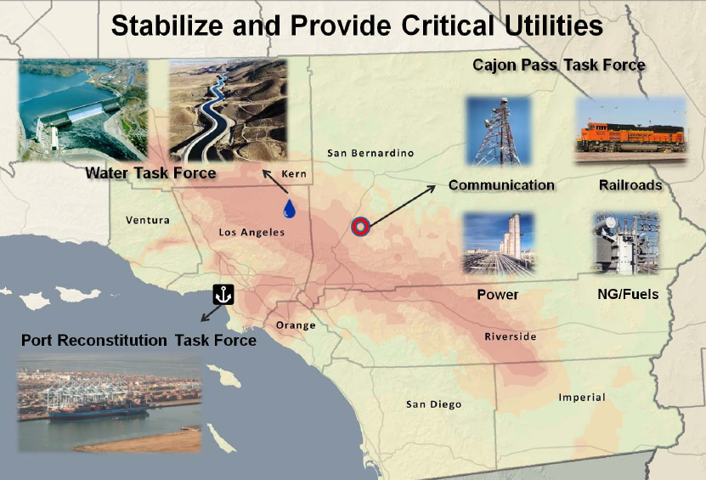
Critical Concerns
Triage of critical infrastructure systems to enable communications, water distribution, power generation, fuel refinement, and air operations is prioritized by the UCG as temporary sources of water, power, and fuel.
Key to the successful execution of the mission above is the activation of three important Task Forces:
  Cajon Pass Task Force
  Port Reconstruction Task Force
  Water Conveyance Task Force
Notes:
This OPLAN has developed joint private sector and government Task Forces for Water, Port Reconstitution (water, power, staging), and the Cajon Pass and Other Critical Infrastructure (power/fuel/communications, railroads) the Task Forces are activated by the joint State/Federal Operations Section to facilitate triage of critical infrastructure systems.
OPLAN has further established relationships within the private sector to carry out response operations and to set conditions for long-term recovery. The private sector owns and operates the majority of critical infrastructure in the region. Specifically, task forces focusing on stabilizing critical systems impacted have been established. These are: The Cajon Pass and other associated Critical Infrastructure, Water, and Port Reconstitution. The role of the state/federal government is to augment and support private sector response as requested.

Slide 13
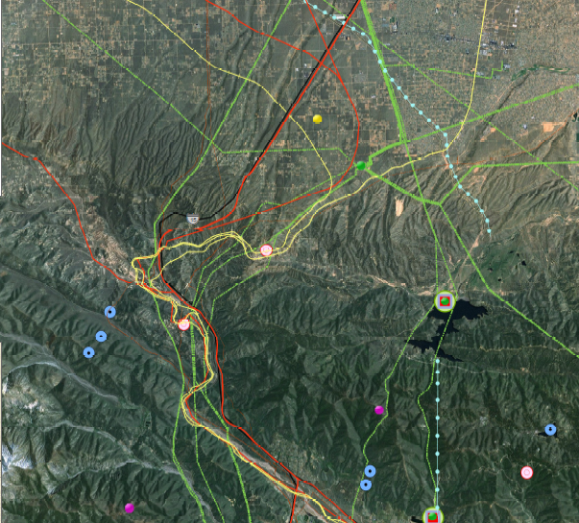
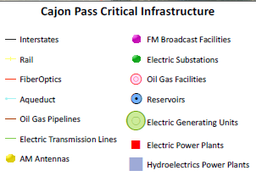
Cajon Pass Task Force (TF)
• Lead: California Utilities Association and ESF-3
• Mission: Coordinate and facilitate the rapid and efficient repair of private sector critical infrastructure. (Power, Communications, Natural Gas and other Fuels, and
Railroads) that passes through the Cajon Pass and other critical locations damaged by the earthquake
End State: Restoration of basic services (Power, communications, Natural Gas and other Fuels, and Rail Service) to the affected population and surrounding areas.

Slide 14
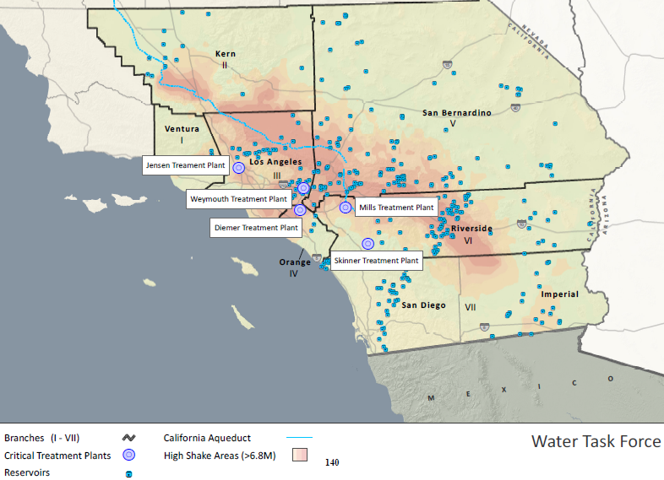
Water Conveyance Task Force
Leads: Department of Water Resources and the Metropolitan Water District of Southern California.
Mission: Coordinate and facilitate the rapid and efficient repair the critical water infrastructure
that provides water resources to affected population in Southern California and surrounding areas.
End State: Restoration of uninterrupted basic water services to the affected population and surrounding areas

Slide 15
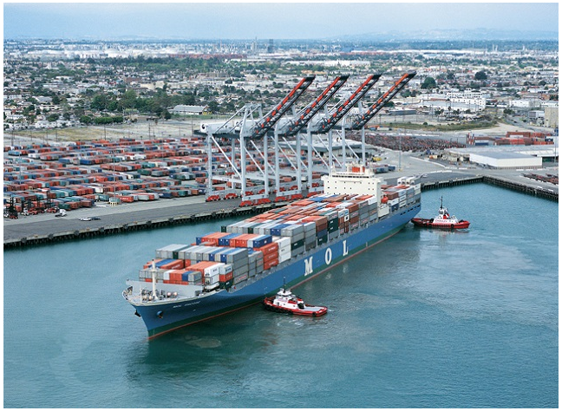
Port Reconstruction Task Force
Lead: United States Coast Guard
Mission: Ensure functionality of the Ports of LB/LA following a catastrophic EQ in order to ensure short term and long term recovery for the LA Region and United States.
End State: Restoration of normal port operations for LA/LB ports supporting both emergency response and commercial operations.
Notes:
Mission: Ensure functionality of the Ports of Los Angeles and Long Beach following a catastrophic earthquake in order to ensure short term and long term recovery for the LA Region and United States.
End State: Restoration of normal port operations for Los Angeles and Long Beach ports with both ports supporting emergency response and commercial operations.
Critical Utilities Restoration: Ships can provide power but must be wired into the port grid by the USACE
The cranes at the ports require 4160 volts and a minimum of 1 MW of power. USACE is conducting ongoing assessments of the port electrical infrastructure to expedite the implementation of temporary emergency power.

Slide 16
Port Reconstruction Task Force
The following are requirements needed to return the port to base level of
operations following a catastrophic earthquake. The ports will serve as staging areas
1. Food
2. Potable Water
3. Sanitation
4. Fuel
i. For Generators
ii. For Vehicles
iii. Aviation
iv. Compressed Natural Gas
5. Material Handling Equipment (MHE)
6. Security
7. Transportation for Ship Seniors
USACE supports critical utilities restoration wiring ships into the port grid
USACE conducts ongoing assessments of the port electrical infrastructure to expedite the implementation of temporary emergency power
USACE and ESF 12 reroute and step down bulk petroleum conveyance directly to loading racks from ships
USACE provides specialized equipment ie salvage tugs & barges
USACE: begin route clearance and bridge repair operations including key routes outwards from ports
USACE support channel surveys if requested
Notes:
6. USCG Completes the following tasks: • With the USACE, develop and communicate port-specific recovery
Caltrans completes the following tasks:• USACE: support the reroute and step down bulk petroleum conveyance directly to loading racks from ships. • USACE: begin route clearance and bridge repair operations including key routes outwards from ports.

Slide 17
Bundled PSMA for SoCal Earthquake
Total $129,380,000
SOUTHERN CALIFORNIA (NRCC) | PAX | TYPE | DFA | FOS
NRCC National Activation | 12 | FOS |  | $255,000
Structures Specialists for US&R support | 26 | FOS |  | $1,200,000
Generator Leasing | 4 | FOS |  | $7,100,000
Bottled and Bulk Water | 23 | DFA | $71,000,000
Total DFA/FOS |  |  | $71,000,000 | $8,555,000
SOUTHERN CALIFORNIA (RRCC/JFO) |  | TYPE | DFA | FOS
Regional Activation (RRCC/JFO/RFO/AFO) | 20 | FOS |  | $4,200,000
Commodities Distribution | 134 | FOS |  | $6,000,000
Deployable Tactical Operations System | 22 | FOS |  | $1,200,000
Infrastructure Assessment | 56 | FOS |  | $3,000,000
Temporary Housing | 4 | FOS |  | $220,000
Logistics | 5 | FOS |  | $225,000
Remote Sensing / GIS | 7 | FOS |  | $310,000
Recovery Field Office Operations | 0 | FOS |  | $3,000,000
Local Government Liaison | 18 | FOS |  | $810,000
Temporary Emergency Power | 418 | DFA | $13,200,000
Debris Management | 40 | DFA | $5,000,000
Critical Public Facilities | 22 | DFA | $3,000,000
Temporary Housing-Site Design | 39 | DFA | $3,000,000
Technical Assistance | 35 | DFA | $4,600,000
Drinking Water Safety & Waste Water IA to State | 10 | DFA | $1,550,000
Drinking Water Safety & Waste Water Infrastructure Assessment and Repair | 12 | DFA | $510,000
Regional DFA/FOS Total |  |  | $30,860,000 | $18,965,000
DFA/FOS Bundle Total | 907 |  | $101,860,000 | $27,520,000
Notes:
50

Slide 18
Urban Search & Rescue
8 of 28 National Urban Search and Rescue task forces reside in SoCal
Estimated 5-10 high rises will collapse, ~800 10+ story buildings are in the impact area. ~5000 rescues from collapsed structures may be necessary.
Size Large US&R Structures Specialist Cadre (26 pax) deployed as part of the bundle (14 day deployment)
Structures Specialist Cadre deploys to LAX
Six-person Structures Specialists Advanced Strike Team reports to FEMA US&R IST
Remaining Structures Specialist Cadre to supplement US&R Task Forces
Bundled PSMA
Notes:
94% are firefighters who are also responsible for firefighting, hazardous materials, and emergency medical services (EMS).

Slide 19
Emergency Power
Generator Leasing
  2 @ 54 packs and 20-25 high end gens for 30 days
2 Type 1 Emergency Power Teams supporting
  Cajon Pass Task Force
  Port Reconstructions Task Force
  North-West ISB at Burbank Airport
  South-East ISB at March Air Force Base
Temporary Housing
Temporary Housing Task Force support
Critical Public Facilities Mission
Temporary Housing Site Design
Bundled PSMA

Slide 20
National Water
200 trucks per day for 30 days ($61M)
Bulk Water for 30 days ($10M)
Combined Commodities
    Deploy Type 1 Commodities Team
    Report and track ~50 Points of Distribution
    Assist FEMA with manning for commodities at ~ 3 Staging Areas
    24 hour operations
Bundled PSMA

Slide 21
Debris
USACE will Conduct Debris Clearance and Disposal Mission
  The catastrophic event will create approximately 81 million tons of debris in the impacted area.
  Most of the 76 landfills are near capacity and debris removal efforts will require an additional amount of capacity that exceeds that which is available.
  Lack of water for fire suppression will burn over 4500 acres which equates to 133,000 single-family dwellings and $65 billion dollars in property loss
USACE will deploy debris removal Planning and Response Teams, (PRTs), heavy equipment and demolition services to help fire suppression at the request and in support of Cal EMA Fire and Rescue EOC or SOC.
Support for animal carcass disposal
Bundled PSMA
Notes:
USACE conducts the following tasks:
• Heavy equipment and demolition services to help fire suppression.
• Response and recovery assistance for contaminated debris removal.

Slide 22
Debris Management
    At $16/CY, the contract will run $120K/day. USACE personnel required to support the mission would total 40. (10 PRT members, 25 QA inspectors, and 5 supporting area engineers).
    Estimate $150K for contractor mobilization. Approximately 225,000 CY will be removed and disposed of in a 30-day period. Costs could vary significantly based on haul distance to disposal site.
    10 crews (each crew consisting of four [4] trucks and one [1] front-end loader) removing and disposing of 750 cubic yards (CY) of debris/crew/day for 30 days.
Debris Management
Un-appropriated = Regular + OT 1 Person 12 hrs/day X7 days | Per 12 Hour Shift | Daily Cost @ 40 per day | Total Cost (30 days)
Regular Time (40 hrs X $59.89) | $480 | $19,200 | $576,000
Overtime (44 hrs X $59.89) | $377 | $15,080 | $452,400
Benefits @ 39% per CBO | $187 | $7,488 | $224,640
Lodging + M&IE | $300 | $12,000 | $360,000
Air fare | $115 | $32,000 | $32,000
Miscellaneous Expenses | $25 | $1,000 | $30,000
Rental Car @ $35/day | $35 | $1,400 | $42,000
Parking at @ $25/day | $25 | $1,000 | $30,000
Gas | $6 | $240 | $7,200
Daily Burn Rate (DBR) / shift | $1,550 | $89,408 | $1,754,240
Contract Mobilization |  |  | $150,000
Debris ACI (10 crews) |  |  | $3,000,000
Total |  |  | $4,904,240

Slide 23
Infrastructure Assessment
Over 300,000 buildings are significantly damaged (1 in 16) and require inspection.
USACE Infrastructure Assessment Teams conduct rapid structural and nonstructural assessments of potentially affected public infrastructure in branches and divisions. Assets are mission assigned under ESF 3.
Infrastructure Assessment Management Cell coordinates & provides accountability for USACE personnel deployed under Technical Assistance and Urban Search and Rescue, Water/Waste Water mission assignments.
Bundled PSMA
Notes:
4. United States Army Corps of Engineers (USACE) activates and prepares to
deploy the Infrastructure Assessment (IA) Planning and Response Team
(PRT).
5. USACE addresses requests for SAP assistance from the State.

Slide 24
Drinking Water Safety & Water / Waste Water IA to State
Drinking Water Safety & Water / Waste Water IA & Repair
Deploy Water Sector Technical Assistance (WSTA) team members/SMEs
Deploy personnel to coordinate and execute all necessary assessments, evaluation, and design/build response and recovery actions associated with ensuring the safety of drinking water and wastewater systems
USACE support to Water Conveyance Task Force
USACE support to Water/Waste Water system restoration
USACE supports EPA / State due to San Bernardino and Riverside counties possibly releasing untreated sewage into the Santa Ana River due to damage to the system and lack of power supply, which would directly affect environmental conditions in the river as well as water supplies through contamination of groundwater spreading grounds over a long period of time.
Bundled PSMA

Slide 25
Long Term Recovery Actions – ISF #5
Stabilize and Provide Critical Utilities for Priority Infrastructure: Water/Wastewater, Power, Natural Gas
Rebuild Schools, critical facilities
Road/Highway infrastructure
Lay new pipe rather than repair the existing infrastructure
Ordered, manufactured, and constructed Transmission towers for full service on major 500 kV lines.
The two nuclear sites in San Diego and San Luis Obispo counties will be shut down and cooled down regardless if damages occur or not. Nuclear facilities have a limited number of certified operators.
Repair/replace damaged 30+ inch natural gas transmission lines that cross the fault in Los Angeles, Riverside and San Bernardino counties
Transition sheltering from temporary housing to rebuilt or repaired homes or other temporary housing.
Restore full commercial capability to the Ports of LA/Long Beach
Restore critical conveyance infrastructure at Cajon Pass for natural gas, power and communications is functional.
Restore major water conveyance structures including the Arizona Aqueduct and the California Aqueduct supplying water to major water treatment facilities in the incident area.
Repair/Restore temporary and repaired power generation infrastructure which enables communications, water and fuel distribution, sanitation, and increased public messaging

Slide 26

Questions

Slide 27
Pre Scripted Mission Assignment Bundle #1 PART C
Regional Activation (RRCC/JFO),( FOS) ($4,200,000)
  Statement of Work: Activate the USACE to perform functions of Emergency Support Function (ESF) #3 at the direction and coordination of FEMA. This activation may include support to FEMA Region IX RRCC, IOF/JFO, Incident Management Support Teams (IMAT), ESF #5- Emergency Management, and other teams. This activation also may include contract audit support to ensure costs incurred under USACE MA meet all Stafford Act and regulatory requirements, at the direction and coordination of FEMA. ESF #3 Team Leader and site-specific support staff may be used, including Prime Power and administrative and management support, and/or other mission Subject Matter Experts (SME), some of which may be operating at the Recovery Field Office (RFO), if operational. ESF #3 Support Agency representatives may be activated to serve as liaisons to the ESF #3 Management Team for public works/infrastructure assistance. ,Perform pre and post event modeling and validation. Equipment purchases are not authorized under this Mission Assignment. MA task orders will be issued for specific personnel requirements, location(s), dates, and duration of assignment(s).
  Initial Task Order:
    Deploy approximately 20 personnel to include some combination of Team Leaders, Assistant Team Leaders, Subject Matter Experts, and Public Affairs supporting RRCC, IMAT/IOF/JFO, and RFO/AFO. ($900,000)
    Initial RFO/AFO staffing and site-specific administrative/ management support at the RFO and other locations varying based on the magnitude and duration of the response and recovery operations. Initial task order estimates are for one RFO and four AFOs aligning with priority FEMA divisions. Estimated startup and 30 days of staffing costs used for calculations of this task order $1,000,000 for RFO and $ $500,000 per AFO, totaling $3,000,000. ($3,000,000)
    Agency Activation to support ESF #3 supporting agency representation and support, if required, is estimated to be $300K. This support deploys ~eight (8) personnel for ~30 days and includes overtime, supplies, travel, and per diem. ($300,000)

Slide 28
Regional Activation Breakdown
Regional Activation
Un-appropriated = Regular + OT 1 Person 12 hrs/day X7 days | Per 12 Hour Shift | Daily Cost @ 20 per day | Total Cost (30 days)
Regular Time (40 hrs X $59.89) | $480 | $9,600 | $288,000
Overtime (44 hrs X $59.89) | $377 | $7,540 | $226,200
Benefits @ 39% per CBO | $187 | $3,744 | $112,320
Lodging + M&IE | $300 | $6,000 | $180,000
Air fare | $115 | $16,000 | $16,000
Miscellaneous Expenses | $25 | $500 | $15,000
Rental Car @ $35/day | $35 | $700 | $21,000
Parking at @ $25/day | $25 | $500 | $15,000
Gas | $6 | $120 | $3,600
Agency Activation |  |  | $300,000
Initial overhead staffing RFO (1)/AFO (4) |  |  | $3,000,000
Daily Burn Rate (DBR) / shift | $1,550 | $44,704 | $4,177,120
Notes:
1 @ $1million, 4 @ $500,000

Slide 29
Division Operational Phases
Phase/EOC Activation Level | Time-line (Hours) | Goal
Normal Operations (Level IV) |  | Preparation Early Impact Prediction
I – Activation (Level III) | Pre – E-72 | Activate Command, Control (C2)
IIa – Deployment (Level II/Level I) | E-72 - E-48 | Activate and Deploy Response Teams & Resources
IIb – Deployment (Level I) | E-48 – Event | Deploy Response Teams Forward
NO NOTICE EVENT | Combine Phase 1, 2a, and 2b activities | Activate Command, Control (C2) Activate and Deploy Response Teams & Resources Deploy Response Teams Forward
III – Execution (Level I) | Event– E+12 | Rapid Needs Assessment
IV – Recovery (Level / II) | After E+12 | Swift Provision of Life Sustaining Goods and Services
V – Closeout
Annex A
Base
Notes:
Level 1 (Pre 72 hr) (examples: Flood/snowmelt/ predicted rain on fire damaged denuded water shed)
Issue WARNORD
Activate Staff and EOCs
Request mission models if needed
Identify & deploy RRCC ESF#3
Initiate coordination for ULA Support
Initiate coordination for ACE-IT Support
Provide Planning Scenario & Assumptions
Receive Pre-scripted Missions
Coordinate with FEMA and State Partners
Identify FEMA ISB and SPD Intermediate Staging Locations
Submit EOC Response Org and begin Reporting in ENGLINK
Level 2a (72-48 yr)
Deploy Combined Commodities & Emergency Power PRTs Assets as needed
Request UOC to alert non-SPD PRTs, DTOS, Functional PRTs, 249th & ESF#3 TLs
Notify Supporting District
Deploy Debris, Roofing and/or Housing SMEs
Level 2b (48-> event)
Confirm/Assign District Cdr as Division Forward Cdr

Slide 30
Dam Safety
Event is anticipated to yield evidence of distress, such as localized cracking, deformations, seepage, or differential movement…Inspections should be conducted IAW project specific plans.
dams
Conservative approaches will be used regarding Water Management decisions, until information confirms project operability. Efforts may be required to lower reservoirs to protect against seepage or stability induced dam failures. Releases may put water upon downstream levees.

Slide 31
Navigation Concerns for SoCal EQ
Ports of Long Beach and Los Angeles aren
Coastal Ports may be the only way to access and deliver aid to coastal communities post EQ.
USACE floating plant may be unavailable. Likely not suitable for response/recovery work

Slide 32
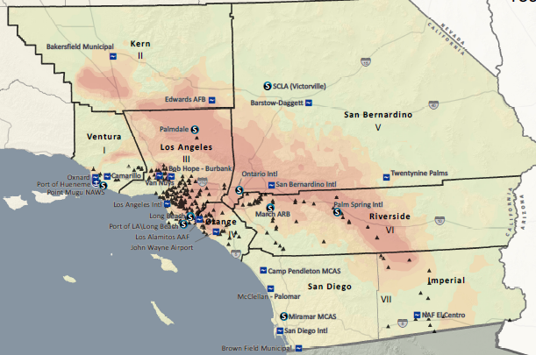
Points of Distribution

Slide 33
Sister-District Relationships
    Los Angeles District will be impacted. The 910 Wilshire Building is expected to be severely damaged.
    SPL Alternate COOP site is Project Office in Arizona
    Sacramento District is the lead supporting district for a SoCal EQ. SPK will coordinate ESF #3 response/ execution on behalf of SPL
    Upon reconstitution SPL will reclaim active missions and mange mission execution to completion
    SPL will lead ISF #5 long term recovery efforts
Base
Notes:
Supported district has an event occur within their AOR and use supporting district to augment their response
Impacted district has an event occur within their AOR that requires them to execute their COOP.
Supporting district begins coordination and execution of impacted district response activities until impacted district is capable to assume response activities from supported district.

Slide 34
Lead District Operational Phases and Key Actions
Phase/EOC Activation Level | Time-line (hours) | Goal | Key Decisions
Normal Operations (Level IV) | > E-168-E-120 | Preparation Early Impact Prediction
I – Activation (Level III) | E-120 – E-72 | Activate C2 | Request prediction models
IIa – Deployment (Level II) | E-120 – E-48 | Activate and Deploy Response Teams & Resources
IIb – Deployment (Level II/Level I) | E-48 – Event | Deploy Response Teams Forward
NO NOTICE EVENT | Combine Phase 1, 2a, and 2b activities | Activate Command, Control (C2) Activate and Deploy Response Teams & Resources Deploy Response Teams Forward | 1. Request Code 210 funding 1. Activate Staff and EOCs 1. Establish Battle Rhythm 1. Notify personnel who will be tasked from other districts 1. Initial SITREP 2. Request Support Personnel, as required 2. Reserve Lodging/Vehicles for TDY Support Personnel 2. Secure Vessels and Projects 2. Begin Execution of bundled PSMA 3. In-process Initial Response Cadre 3. ISB Established and Staffed
III – Execution (Level I) | Event – E+12 | Rapid Needs Assessment | Deploy PDA teams Over-fly AO (Commander & designated personnel) Contact Customers
IV – Recovery (Level I/Level II) | After E+12 | Swift Provision of Life Sustaining Goods and Services | Validate State's Response Needs (Water/Power/IA)
V – Closeout |  |  | Physical and fiscal completion of all missions
Base
Notes:
Level 1
Request Code 210 funding
Activate Staff and EOCs
Establish Battle Rhythm
Request prediction models
Notify personnel who will be tasked from other districts
Initial SITREP
Level 2
Request Support Personnel, as required
Dismiss Non-Essential Staff
Reserve Lodging/Vehicles for TDY Support Personnel
Secure Vessels and Projects
Receive & Execute Pre-Declaration Missions
Level 3
In-process Initial Response Cadre
ISB Established and Staffed
Execute Post-Dec MAs

Slide 35
ESF #3 Teams and Cadre
 | SPDHQ | SPA | SPK | SPL | SPN
ESF 3 Team Leader Cadre | 2 |  | 1
ESF 3 Assistant Team Leader Cadre | 1 |  |  |  | 1
ESF 3 Local Government Liaison |  | 1 | 3
LEAD: Urban Search and Rescue Structures Specialist Cadre | 1 |  | 6 | 3
LEAD: Infrastructure Assessment PRT |  |  | 1
Combined Commodities PRT |  |  |  |  | 1
Contingency Support Team PRT (Regional) | 1
Debris Removal PRT |  |  | 1
Emergency Power PRT |  | 1
Temporary Housing PRT |  |  |  | 1
DTOS PRT & ECCV |  |  | 3 | 1
ESF 15 External Affairs Cadre | 1 | 1 | 2 | 4
GIS/Remote Sensing Cadre |  |  | 3
Safety Occupational Health Cadre |  | 2 | 3 |  | 1
ENGLink Strike Team Cadre |  |  | 1
Annex A

Slide 36
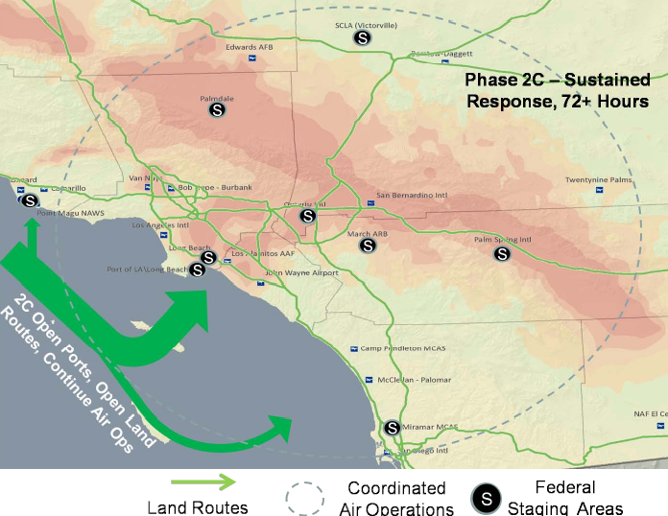

Slide 37
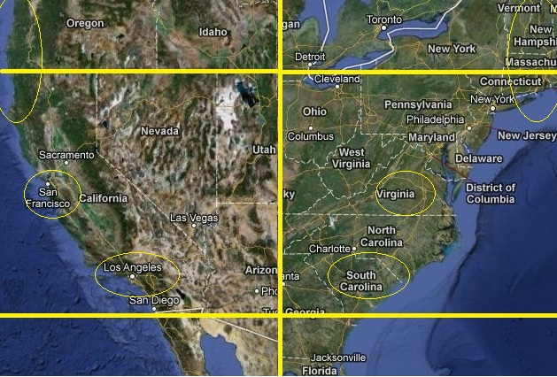
California Capability
California has 58 counties (aka Operational Areas), each with EOC and field response capability
After an incident
CalOES Activates the SOC
(Sacramento) and REOC
and FEMA activates the
NRCC & RRCC (Oakland)
Nearly 400 miles from
CalOES, Sacramento &
Los Angeles
Wash, DC-Charlotte NC
Notes:
VOADs requested to integrate into the JFO will be coordinated by EF 17 Voluntary and Donations Management. The EF lead will
be responsible for resources with needs.
(1) Southern California State Voluntary Organizations Active in Disasters (SCVOAD) – coordinates with the National VOAD, relevant government agencies such as FEMA’s Voluntary Agency Liaisons and NGOs in the provision of assistance to individuals and families in recovering from a disaster.
(2) American Red Cross (ARC) - provides shelter, food, counseling and disaster planning preparedness, response and recovery activities as well as subject matter experts.
PRIVATE SECTOR COORDINATION REQUIREMENTS
Cal EMA has signed Memorandums of Understanding (MOU) with the following: California Grocers Association, Target Corporation, Lowes HIW Inc., Wal-Mart Stores, Inc., and the California Utilities Emergency Association. These relationships will continue to grow as private sector partners participate in exercises and planning.

