Slide 1
Northwestern Division
Value Engineering
as it relates to
Data Reporting
24 February 2015
Version 3
Joe Laird
Military Integration Division
Omaha

Slide 2
Agenda
Scope of the Presentation
Command Management Review (CMR) Overview
  Key Performance Indicators (KPIs)
  Metrics Key Components
  Metrics Key Messages
  Metrics Calculations
  Sample NWD RPRB Slides
Value Engineering Reporting
  New VE EDW Dashboards & Reports
  Sample Dashboard
  Sample Report
  Value Engineering Data Points
QA/QC the Data
Best Business Practices
Live Demonstration

Slide 3
Scope of the Presentation
The Presentation will:
  Provide metrics basics.
  Provide Dashboard/EDW basics.
  Focus on data requirements in P2 that will support VE for the Program Coverage/Compliance Dashboard
  Be applicable to VEOs, PMs, P2 Schedulers, etc.
  Provide introduction to the various venues of reporting (CMR, DMR, etc.).
  Discuss QA/QC of the dataset.
The Presentation will not:
  Focus on data requirements for VERS for the Cost Avoidance/Savings Dashboard
  Will not focus on data sources outside of P2 such as PD2 ⁽¹⁾
  Discuss VE policy, process, etc.
  (1) Contracting Database → PD2, Procurement Desktop-Defense; also known as SPS (Standard Procurement System).

Slide 4
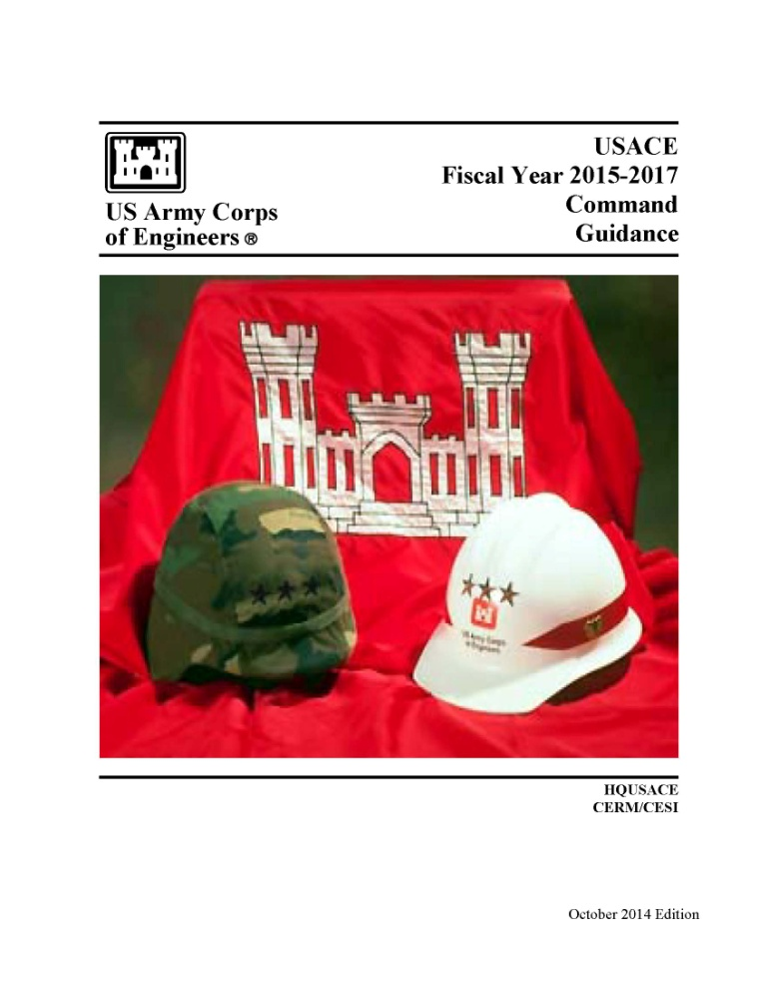

Command Management Review (CMR) Overview
A quarterly review by USACE Commanders of the USACE strategic Campaign Goals/ Objectives and select Command Management Review (CMR)
The Directorate Management Review (DMR) focuses on the metrics as they relate to execution.
DMR recommendations are forwarded to the CMR by individual functional directorates.
The metrics are located at:
  https://intranet.usace.army.mil/hq/rm/CCG/FY15/FY15_CCG_Ch3.pdf
Value Engineering is identified in the Consolidated Command Guidance (CCG) Chapter 3 and 4, under both Military (MILCON, Minor MILCON, Environmental, IIS-Military funded, and SRM) and Civil Works (CW & IIS-Civil funded).
CCG is published yearly.
CONSOLIDATED COMMAND GUIDANCE
Ch 1: USACE Campaign Plan
Ch 2: Resources
Ch 3: Measure of Success
Ch 4: Key Performance Indicators (KPIs)
Notes:
USACE PERFORMANCE MANAGEMENT SYSTEM
The USACE Performance Measurement System, known as the Command Management Review (CMR), is a quarterly review by USACE Commanders of the USACE strategic Campaign Goals/Objectives and select Directorate Management Review (DMR) metrics which focuses on operational performance. This approach focuses on the needs of one HQs and Regional Business Centers (RBC) as described in USACE 2012, linking the USACE Campaign Plan and other strategic guidance to quarterly performance objectives.
The USACE CMR ties strategic and operational performance. The CMR specifically includes discussion and tracking of USACE compliance with the USACE Campaign Plan. While no longer directly oriented toward the Balanced Scorecard, the measurement system requires organization-specific synthesis, alignment, and integration that focus on key results. To this end, individual DMRs within each functional component is a foundation and backdrop to the ultimate analyses provided to decision makers.
During these DMRs, each HQ Directorate and RBC discusses detailed measures related to current operations and initiatives. Out of Tolerance areas discovered during each DMR, or programmatic issues requiring leadership involvement are briefed during the CMR. This quarterly engagement between staff elements enhances understanding and synergy within the organization.
DMR recommendations brought forward by individual functional directorates for briefing at the CMR are presented to the DCG for approval. Following DCG approval these prioritized issues and topics become the areas for the quarterly CMR discussion and ultimate decision making. The DMR metrics are posted on the USACE Website under CCG within the Directorate of Resource Management website.
Completing the circle, the quarterly DMR/CMR process is complemented by the Command Strategic Review (CSR). The CSR assesses the performance of the MSC and their progress in meeting USACE goals and objectives.

Slide 5
Key Performance Indicators (KPIs)
Definition:
  Represent a set of measures focusing on the aspects of organizational performance that are most critical for the current and future success of the organization.
  They are metrics that are either mandated by higher authority or enable organizational effectiveness.
  They are the metrics that best describe the organization’s health.
Characteristics:
  A metric that the Chief (CEO) of the USACE needs to see at every CMR.
  A higher level measure typically fed by data from lower level metrics.
Criteria to Identify KPI (just needs to meet one of these):
  It’s vital to achieving mission success; meaning failure to accomplish the goal results in unacceptable risk to mission success.
  It’s vital to customer requirements; meaning failure to achieve the goal results in unacceptable risk to customer satisfaction.
  It’s vital to satisfying statutory and regulatory requirement.

Slide 6
Metrics Key Components
CMR Metrics Key Performance Indicator (KPI) | DMR Metrics Measure of Success (MofS)
KPIs: SFI 4a, 4b, and 4c (Military and Civil combined) | MofS: Military: MP16, MP17, and MP17a Civil: CW8, CW8a, and CW8b
Metric Components
Criteria to Identify KPI | Proponent
Purpose | Visibility Level
Impacts to Failure | Program & Type Funding Codes
Definition | Data Source
Data Source | Rated
Relationship of Data to What is Measured | Program Years Measured
Metric Calculation | P2 Data / Milestones
Rating Criteria | Goal
 | Purpose
 | Definition
 | Relationship of Data to What is Measured
 | Metrics Calculation
 | Rating Criteria
The CMR and DMR metrics are basically the same measurement . Items in “yellow” further define the metrics goals.
Notes:
Purpose: Provide visibility on the Corps’ ability and effectiveness to financially closeout projects, transfer assets to the installation for timely programming of future O&M SRM funds for the completed projects and meet the Chief Financial Officer’s (CFO) goals.
Goal: Financially close all MILCON Projects in CONUS and OCONUS within 12 and 15 months, respectively, based on the latest BOD (cc850) of all construction contracts executing any portion of the Project.
Definitions and Determination: Project Fiscal Completion_Actual (P2 milestone: ML260) is defined as:
-of claims signed by all contractors and contracts final paid (RMS data element cc880);
-all unobligated design and construction funds returned;
-all obligations liquidated and bills final paid;
-applicable CEFMS Work Items closed;
-CEFMS Construction-in-Progress (CIP) asset account closed by Resource Management and the final CIP assets transferred to the Installation Real Property Book Officer via final DD 1354 showing all design and construction costs.

Slide 7
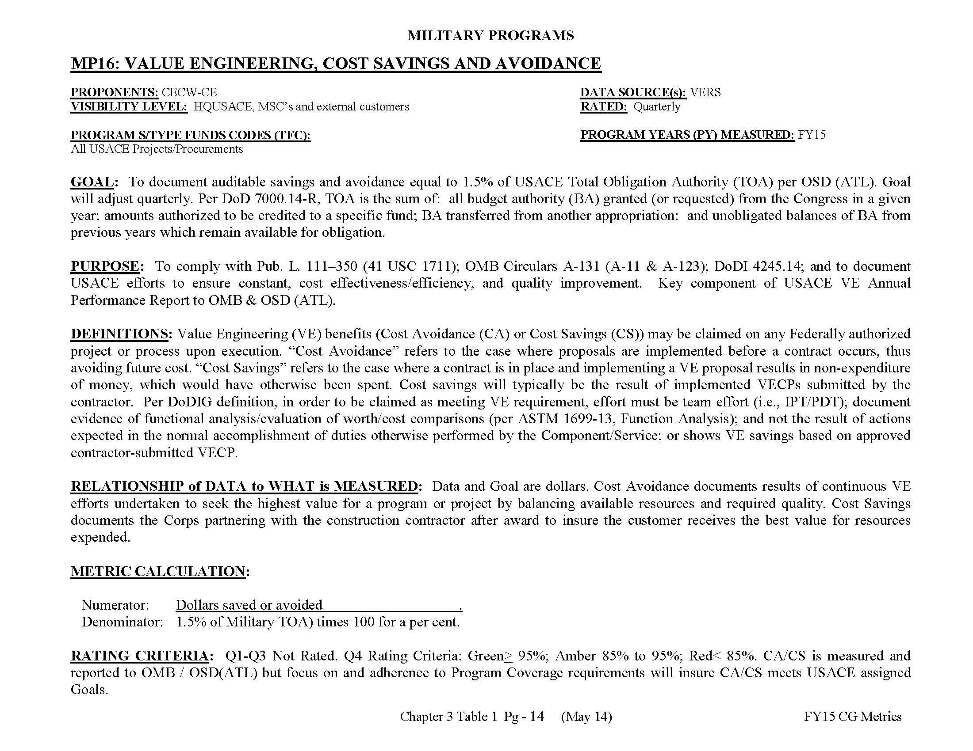
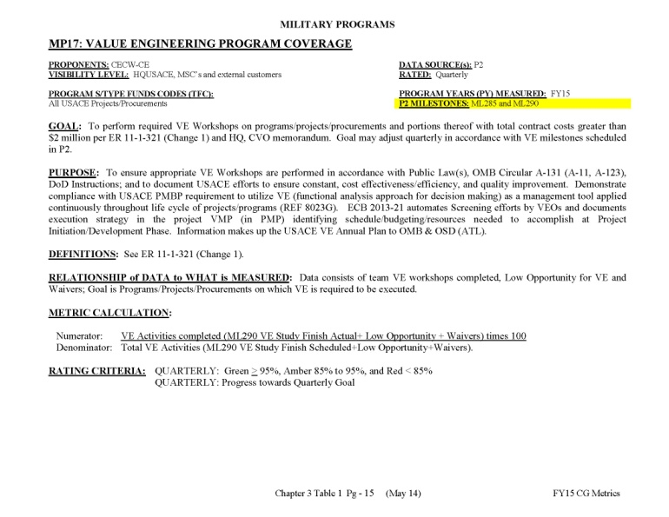
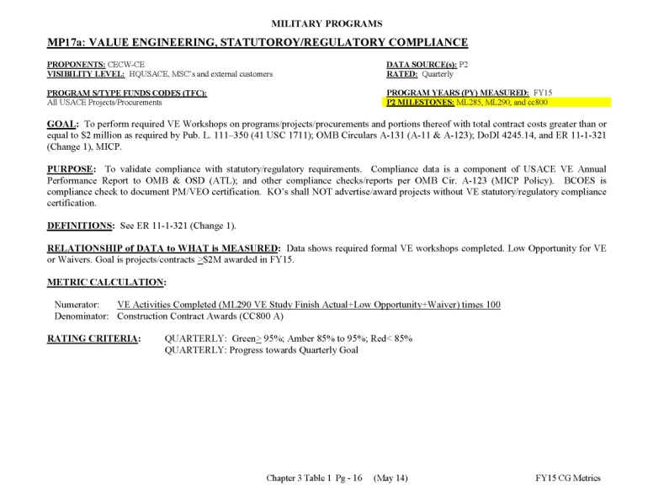
Command Management Review (CMR) Overview
MILITARY PROGRAMS
MP16: Value Engineering, Cost Savings And Avoidance
MP17: Value Engineering Program Coverage
MP17a: Value Engineering, Statutory/Regulatory Compliance
Provided in Backup
Notes:
Excerpt from the
FY13 Consolidated Command Guidance
Chapter 3 Table 1
Pg - 9 (May 12)
Updated Yearly
If you are missing information that affects the metric, look at the CMR and then go back and fix it. This slide is a sample of what the metric looks like and can help you identify what, if any information is missing, as well as provide insight on your criteria may be impacting your project.

Slide 8
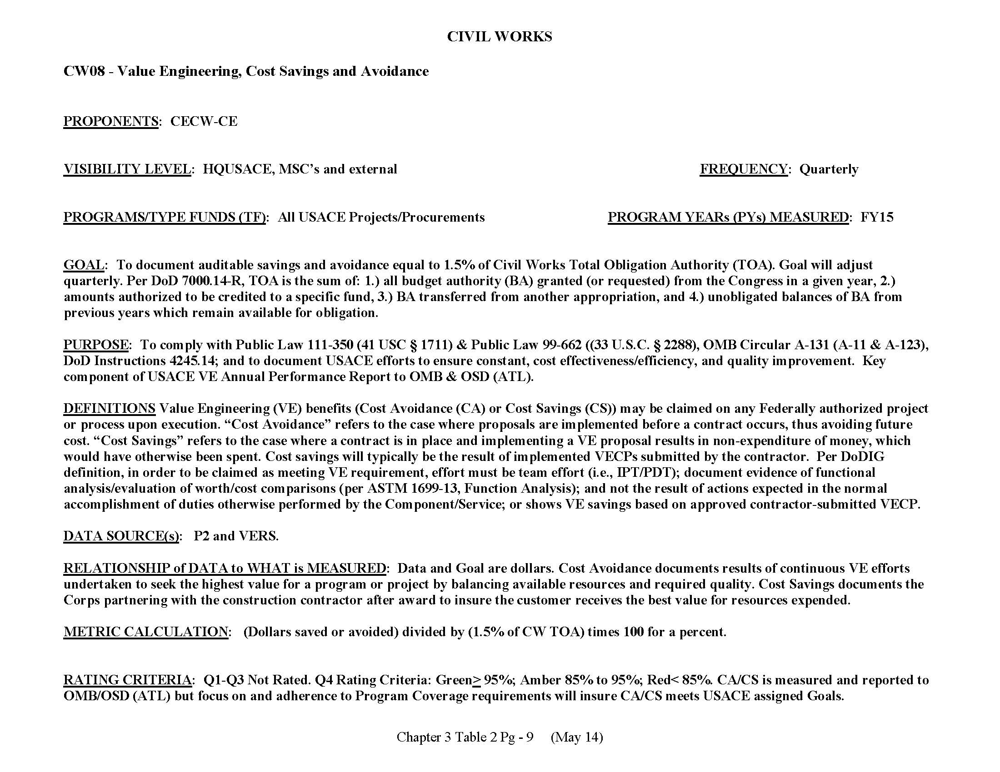
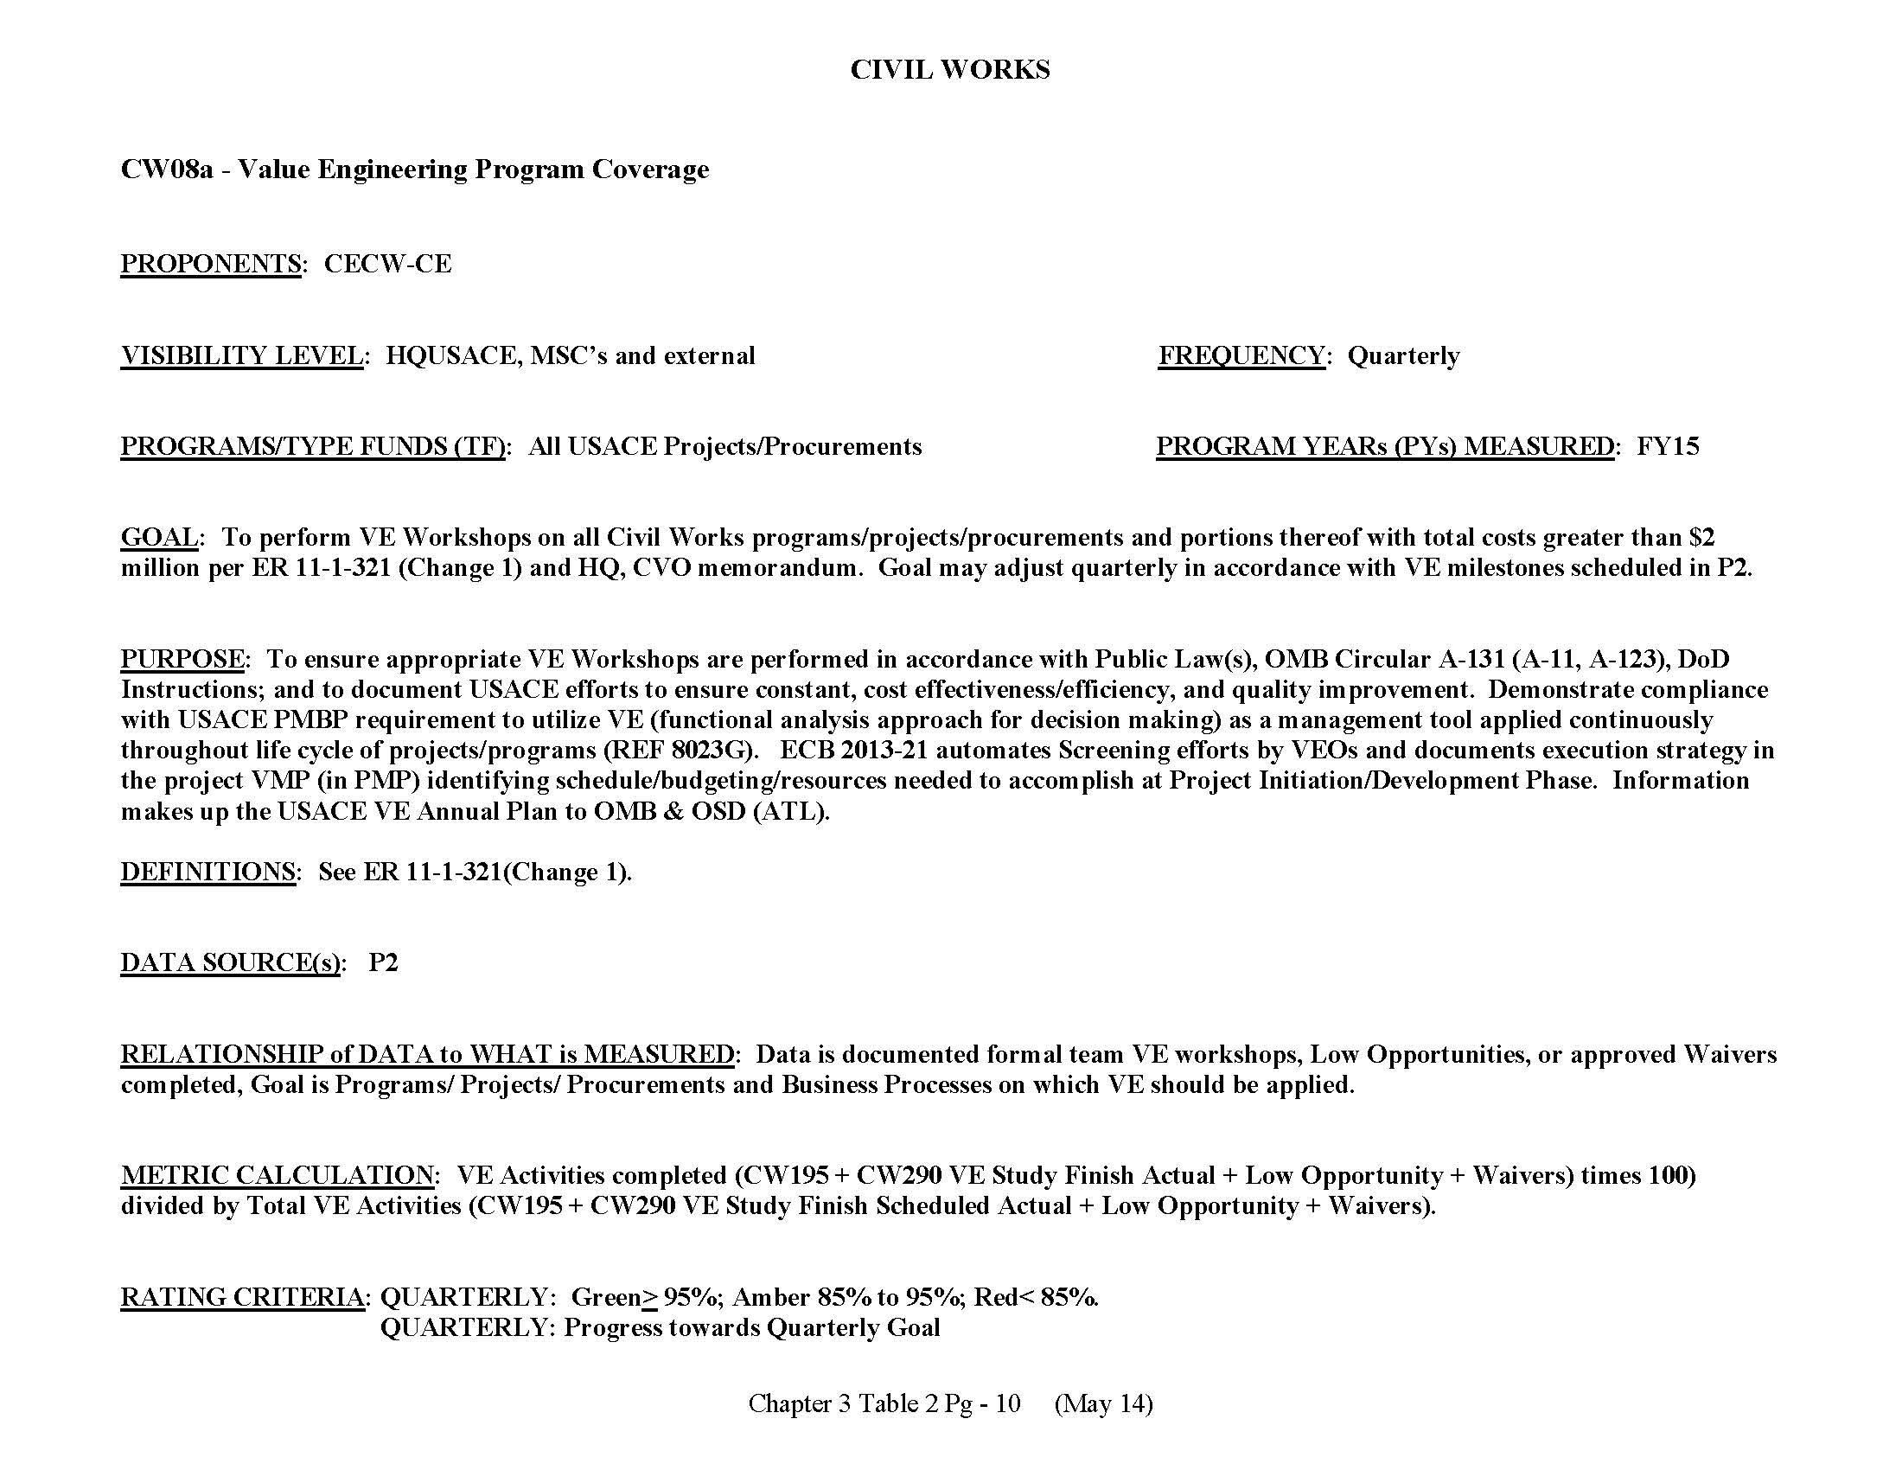
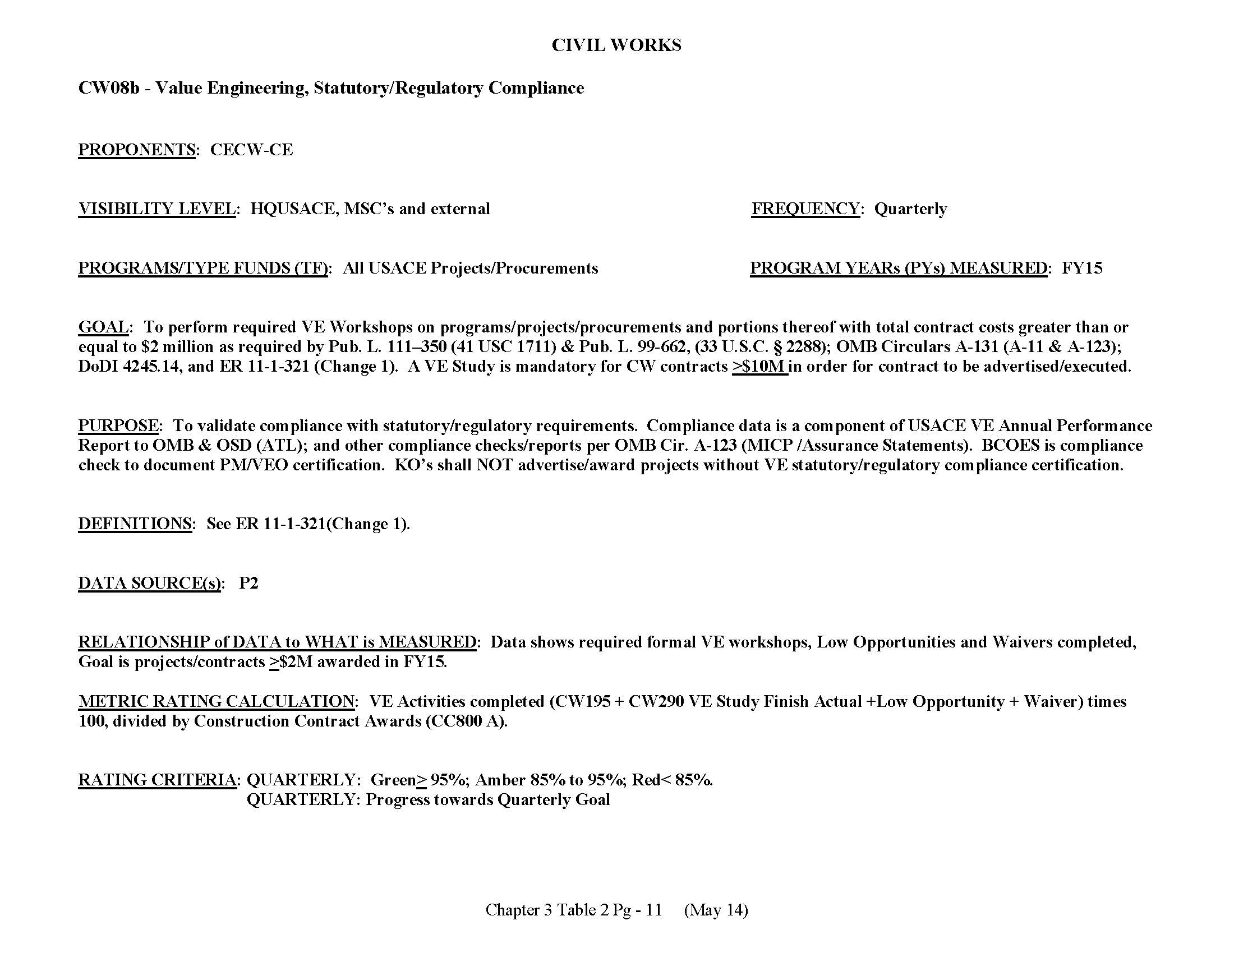
Command Management Review (CMR) Overview
CIVIL WORKS
CW08: Value Engineering, Cost Savings and Avoidance
CW08a: Value Engineering Program Coverage
CW08b: Value Engineering, Statutory/Regulatory Compliance
Provided in Backup
Notes:
Excerpt from the
FY13 Consolidated Command Guidance
Chapter 3 Table 1
Pg - 9 (May 12)
Updated Yearly
If you are missing information that affects the metric, look at the CMR and then go back and fix it. This slide is a sample of what the metric looks like and can help you identify what, if any information is missing, as well as provide insight on your criteria may be impacting your project.

Slide 9
Metrics Key Messages
Goal: Demonstrate that the VE requirements are met in Civil Works and Military Missions for contract costs greater than $2 Million.
  Program Coverage
  Statutory/Regulatory Compliance
Purpose: To ensure compliance to Public Law(s), OMB Circular A-131 (A-11, A-123), DoD Instructions; and to document USACE efforts to ensure constant, cost effectiveness/efficiency, and quality improvement. … Information makes up the USACE VE Annual Plan to OMB & OSD (ATL)
Reporting provides visibility on the Corps’ ability and effectiveness to meet the prescribed goals
Notes:
Purpose: Provide visibility on the Corps’ ability and effectiveness to financially closeout projects, transfer assets to the installation for timely programming of future O&M SRM funds for the completed projects and meet the Chief Financial Officer’s (CFO) goals.
Goal: Financially close all MILCON Projects in CONUS and OCONUS within 12 and 15 months, respectively, based on the latest BOD (cc850) of all construction contracts executing any portion of the Project.
Definitions and Determination: Project Fiscal Completion_Actual (P2 milestone: ML260) is defined as:
-of claims signed by all contractors and contracts final paid (RMS data element cc880);
-all unobligated design and construction funds returned;
-all obligations liquidated and bills final paid;
-applicable CEFMS Work Items closed;
-CEFMS Construction-in-Progress (CIP) asset account closed by Resource Management and the final CIP assets transferred to the Installation Real Property Book Officer via final DD 1354 showing all design and construction costs.

Slide 10
Metrics Calculations
Cost Savings and Avoidance (Rated QTR 4 Only):
Program Coverage:
Statutory/Regulatory Compliance:
% CA/CS Goal = | Dollars Saved or Avoided x 100
 | 1.5% of TOA
Red: < 85%
Amber: >/= 85% - < 95%
Green: =/> 95%
% Program Coverage Goal = | VE Activities Completed (VE Study Finish Actual + Low opportunity + Waiver) times 100
 | Total VE Activities Completed (VE Study Finish Actual + Low opportunity + Waiver)
Red: < 85%
Amber: >/= 85% - < 95%
Green: =/> 95%
% Program Compliance Goal = | VE Activities Completed (VE Study Finish Actual + Low opportunity + Waiver) times 100
 | Construction Contract Awards [Award Date (cc800) Actual]
Red: < 85%
Amber: >/= 85% - < 95%
Green: =/> 95%
VE Study Finish Actual: ML290, CW290, CW195, or EN140
Notes:
(1) Classifications for “Aged” and “Current” have been eliminated from the CCG for MP08. In FY14, durations will be measured in days instead of months (Current-CONUS = 365 days and Current-OCONUS = 456 days).
10

Slide 11
BLUF. VE Is Applicable For All Procurements (PA > $2.0M)
Results are based on MILCON, SRM, and Environmental projects. IIS can be located in either CW or Military.
Query based on VE Milestones (ML285 & ML290).
District PDT needs to QC dataset given a majority of the projects are under $2M
The lack of SRM PIF data makes VE hard to determine where the PA, Project Codes (i.e., Waiver, Low Opportunity, etc.), or Milestone data are blank.
Includes multiple customer requirements that are added to one P2 project making the PA greater than $2.0M.
EDW Data/Dashboards are available at:
-- https://edw.usace.army.mil/
-- Public Folders
-- Value Engineering
Slide Reported at the Last NWD RPRB

Slide 12
BLUF. VE Is Applicable For All Procurements (PA > $2.0M)
Results are based on CW projects. IIS can be located in either CW or Military.
Low numbers could be based on not including the appropriate VE Milestones when the project is initiated.
District PDT needs to QC dataset
EDW Data/Dashboards are available at:
-- https://edw.usace.army.mil/
-- Public Folders
-- Value Engineering
Slide Reported at the Last NWD RPRB

Slide 13
Value Engineering Reporting
Value Engineering EDW Dashboard
  Automates Quarterly/Annual Metric Reports
  Allows MSC/District to perform QA/QC on Metrics and Quarterly/Annual Reports 24/7
  Automates creation of quarterly DMR slides.
  Automates/Assists with preparation of HQ/MSC VE Annual Plans

Slide 14
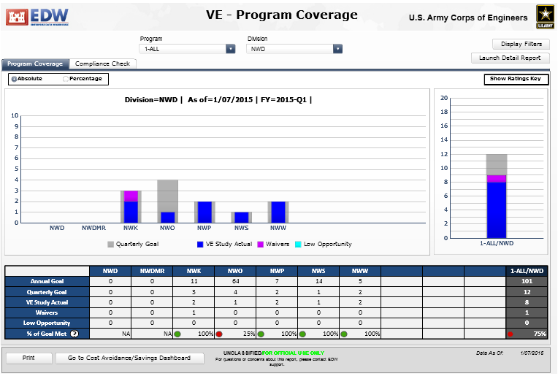
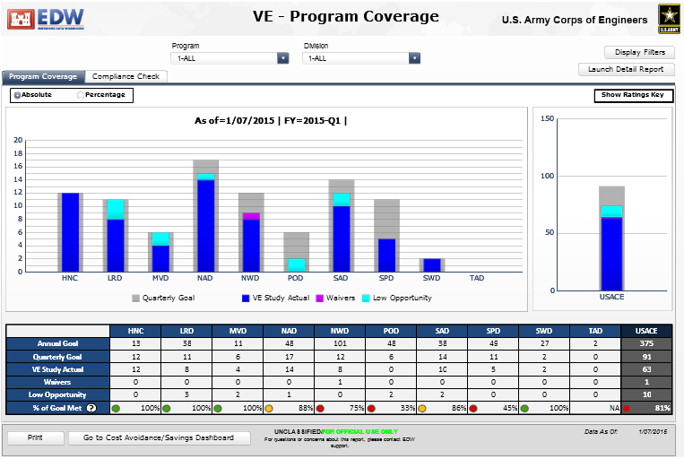
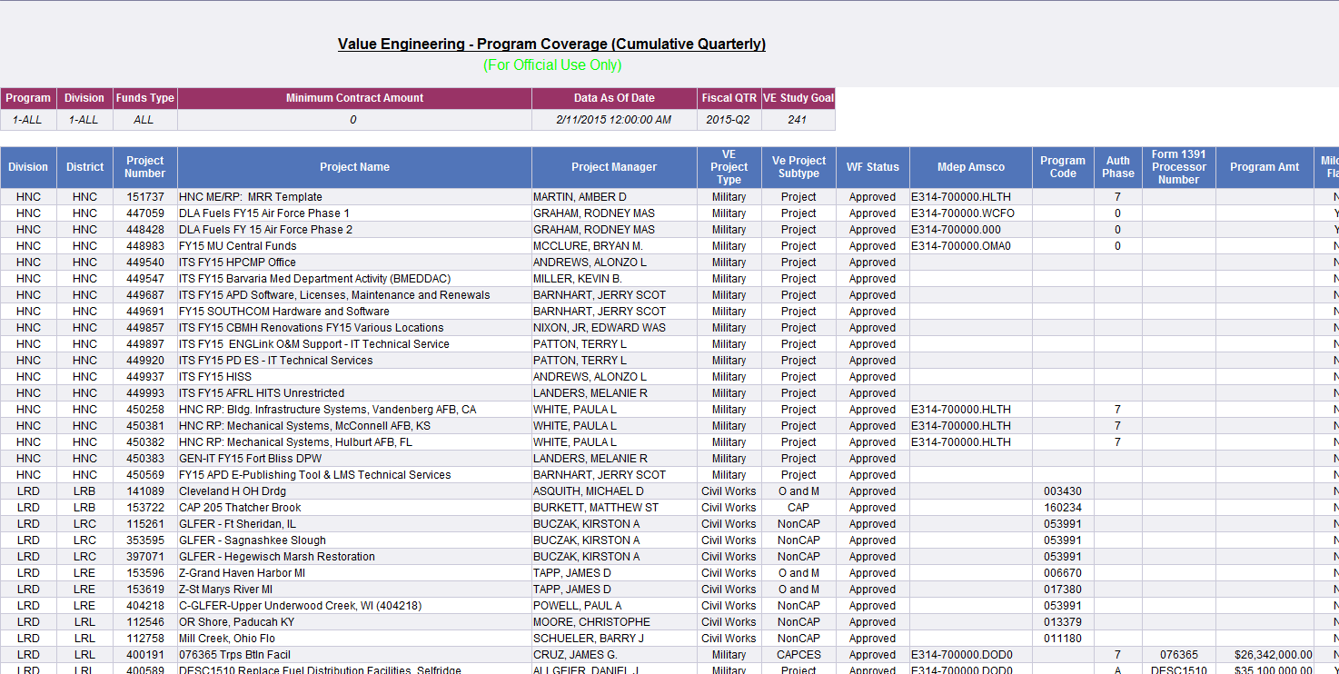
Value Engineering Reporting
VE EDW Reports
VE Dashboard
(by District)
VE Dashboard
(by MSC)
Notes:
These are the various data sources and methods of reporting for project closeout.
The slide provides a snap shot for situational awareness.
14

Slide 15
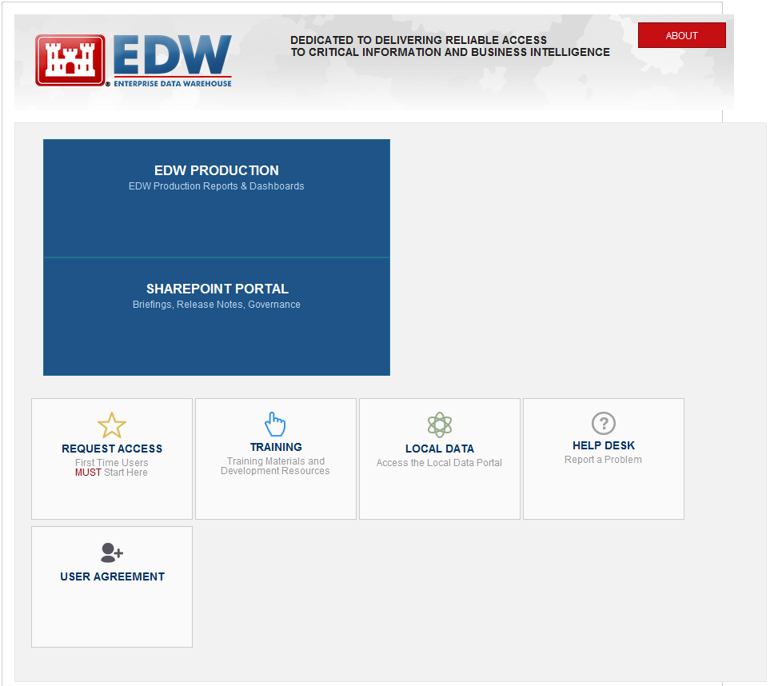
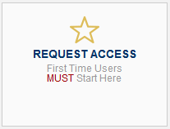
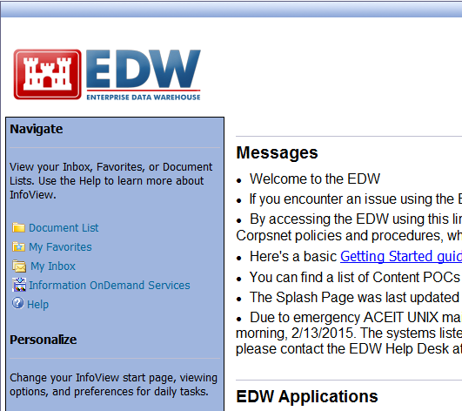
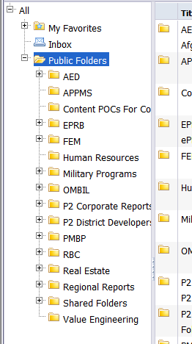
New VE EDW Dashboards & Reports
Go to: https://edw.usace.army.mil/
  Request Access (takes 1 to 2 days)
  Step 1: EDW Production
  Step 2: My Inbox
  Step 3: Expand Public Folders
  Step 4: Go to Bottom of List
Step 1
Step 2
Step 3
First time users only
Step 4
Notes:
Test Question: APPMS – Personal Property System

Slide 16
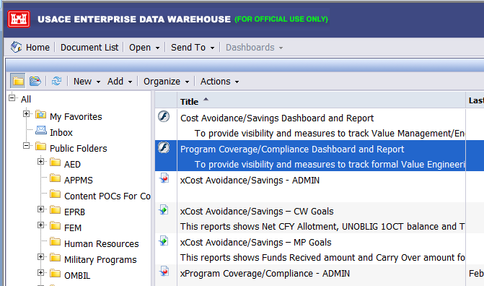
New VE EDW Dashboards & Reports
HQ VE Dashboards Available:
  Cost Avoidance/Saving Dashboard and Report(MP16 or CW08)
  Program Coverage/Compliance Dashboard and Report (MP17, MP17a, CW08a, or CW08b)
HQ VE Reports Available (1):
  xCost Avoidance/Savings – ADMIN
  xCost Avoidance Saving – CW Goals
  xCost Avoidance Savings – MP Goals
  xProgram Coverage/Compliance - ADMIN
Select Dashboard over the Report Option
EDW Data is Updated Nightly.
(1) “x” in report title denotes report only. Highly recommend getting to reports through the dashboard versus the reports options shown.
Notes:
Test Question: APPMS – Personal Property System

Slide 17
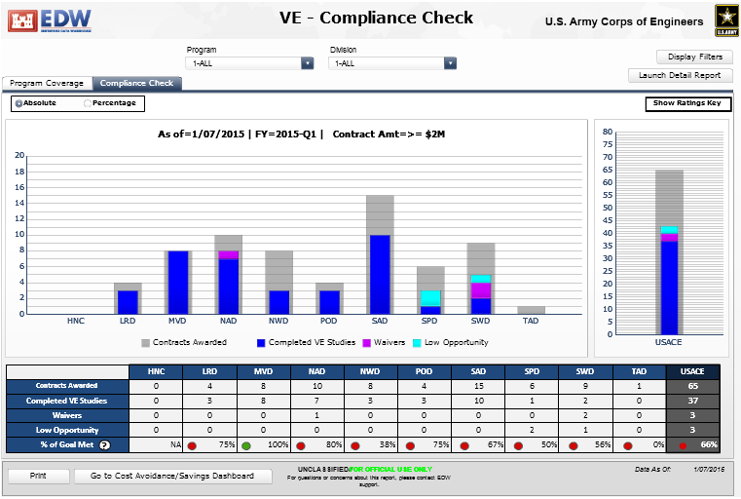
Sample Dashboard

Slide 18
Sample Dashboard

Slide 19
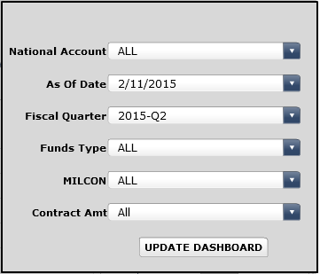
Sample Dashboard
Step 1:
If graphic results are blank, select:
Display Filter
Appropriate Filter (i.e., As of Date)
Update Dashboard
Please Note: Contract Amount (Resourced in P2) defaults to all and not contracts over $2M.

Slide 20
Sample Dashboard

Slide 21
Sample Dashboard
Step 3:
Program: All, CW, or MP
Division: All or by Division
Step 2:
Program Coverage or
Compliance Check
Step 4:
Launch Detail Report
Report pulls:
xProgram Coverage_Compliance - ADMIN.xls
Step 5:
Once complete, you can toggle over to Cost Avoidance/Savings Dashboard
Hover over the:
Dashboard Title will provide Dashboard Rules
Show Rating Key will provide Red/Amber/Green percents

Slide 22
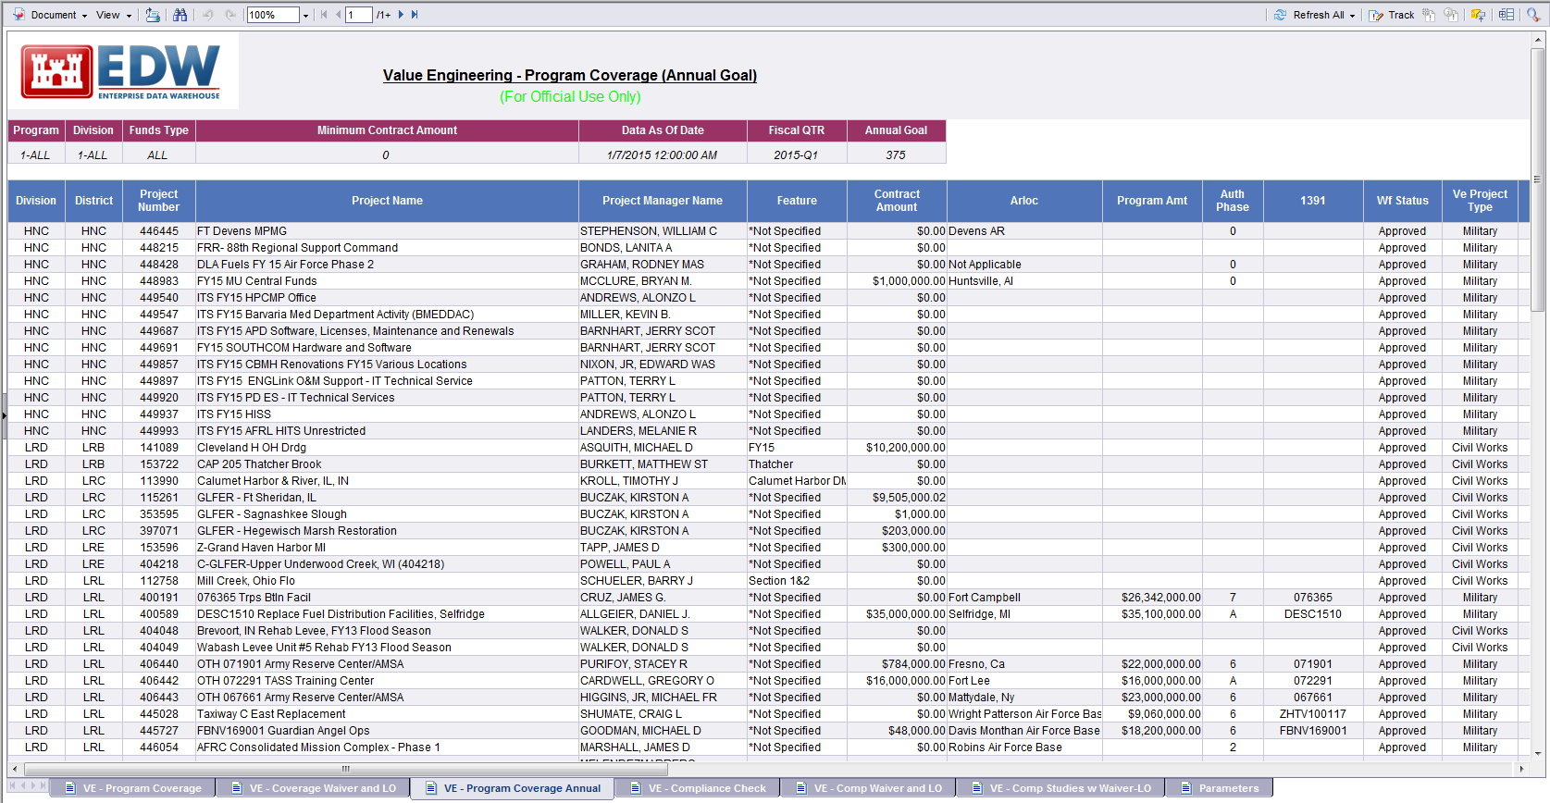
Sample Report
Tabs Available
VE – Program Coverage | VE – Coverage Waiver and LO | VE Program Coverage Annual | VE – Compliance Check
VE – Comp Waiver and LO | VE – Comp Studies w Waiver-LO | Parameters
(1) “Yellow” indicates primary tabs that generate the metric results. “Purple” should also be analyzed for QC for future quarters.

Slide 23
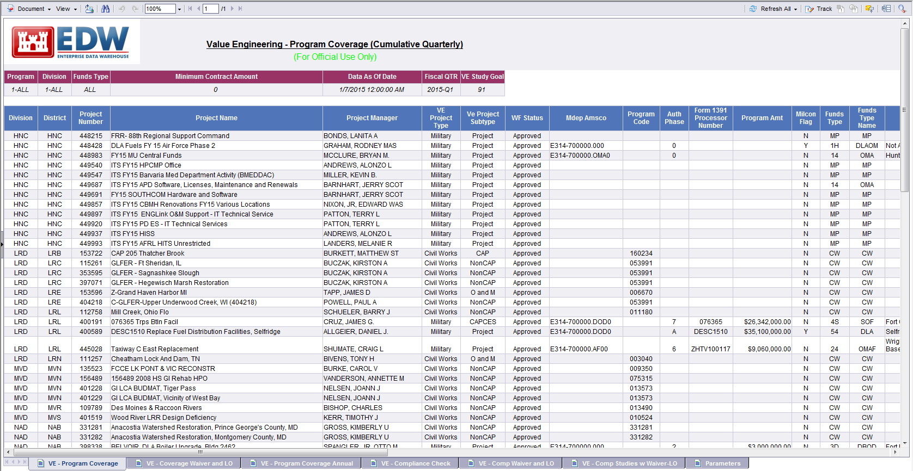
Sample Report
Document: Save flat file to Excel (2003 or 2007), PDF, CSV, or Text
View: Change View Mode
Print: Export to PDF for Printing
Search: Allows searching of data within report.
Zoom: Zoom 10% to 500%
Page: Go to a specific page of the report

Slide 24
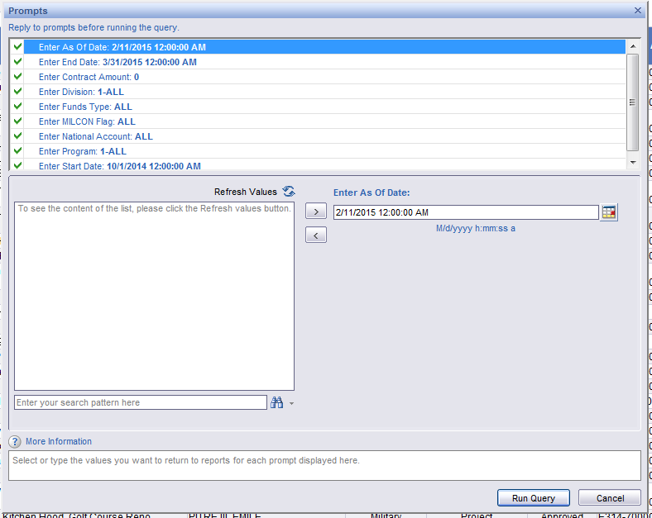
Sample Report
Refresh All: Lets you revise query output based on filters in the prompt
Track: Activate Data Tracking
Unless you are comfortable with the power of the EDW, only use the “Document” export feature and export data to Excel for QC purposes.

Slide 25
  Sample Report
Data fields available for Program Coverage or Compliance Check
Key VE data in query

Slide 26
Value Engineering Data Points
Mission Area | Size of Project (1) (2) | Feature (3) | Waiver (4) | Low Opportunity (4) | Award | VE Start | VE End (4)
Civil Works-Plans & Specs | Contract Resource Amount | Use Defined Filed (UDF) | Waiver Date | Low Opportunity Date | cc800/ cc801 | CW285 | CW290
Civil Works-Feasibility Study | Contract Resource Amount | UDF | Waiver Date | Low Opportunity Date | --- | CW192 | CW195
IIS – Civil Funded (5) | Contract Resource Amount | UDF | Waiver Date | Low Opportunity Date | cc800/ cc801 | CW285 | CW290
MILCON | Contract Resource Amount | UDF | Waiver Date | Low Opportunity Date | cc800/ cc801 | ML285 | ML290
Minor MILCON | Contract Resource Amount | UDF | Waiver Date | Low Opportunity Date | cc800/ cc801 | ML285 | ML290
SRM | Contract Resource Amount | UDF | Waiver Date | Low Opportunity Date | cc800/ cc801 | ML285 | ML290
IIS – Military Funded (5) | Contract Resource Amount | UDF | Waiver Date | Low Opportunity Date | cc800/ cc801 | ML285 | ML290
HTRW | Contract Resource Amount | UDF | Waiver Date | Low Opportunity Date | cc800/ cc801 | EN139 | EN140
Contract Amount is the sum of CONSVCS and OTHCONSVCS resourced amounts in a given FY. If more than one contract is resourced, then the use of Feature codes is required in P2 to relate individual contract activities. Unclear how to QA/QC feature codes as part of data validation. FEATURE is a manually entered text field in Primavera. The only requirement on using the FEATURE code is that all activities belonging to a contract / product must have the same exact value in the FEATURE code field. This field allows you to track multiple VE studies within one P2 number. It is only applicable when you have more than one contract acquisition. A contract/project must have either a VE Study finish milestone date, low opportunity date, or waiver date in the given FY to count for Program Coverage. IIS projects are included in either in MP or CW. Military Fund Type determines where a project falls. If an IIS project has a Military Fund Type it will be reported with MP, if not the project will be reported with CW.
Data Point not in the Flat File

Slide 27
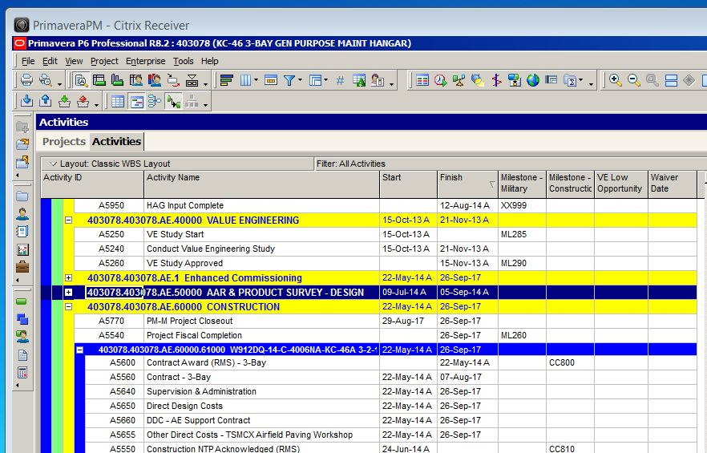
Value Engineering P2 Screenshot
VE Low Opportunity & Waiver Date
VE Study Start (ML285)
Conduct Value Engineering Study (Where Resources are Budgeted)
VE Study Approved (ML290)

Slide 28
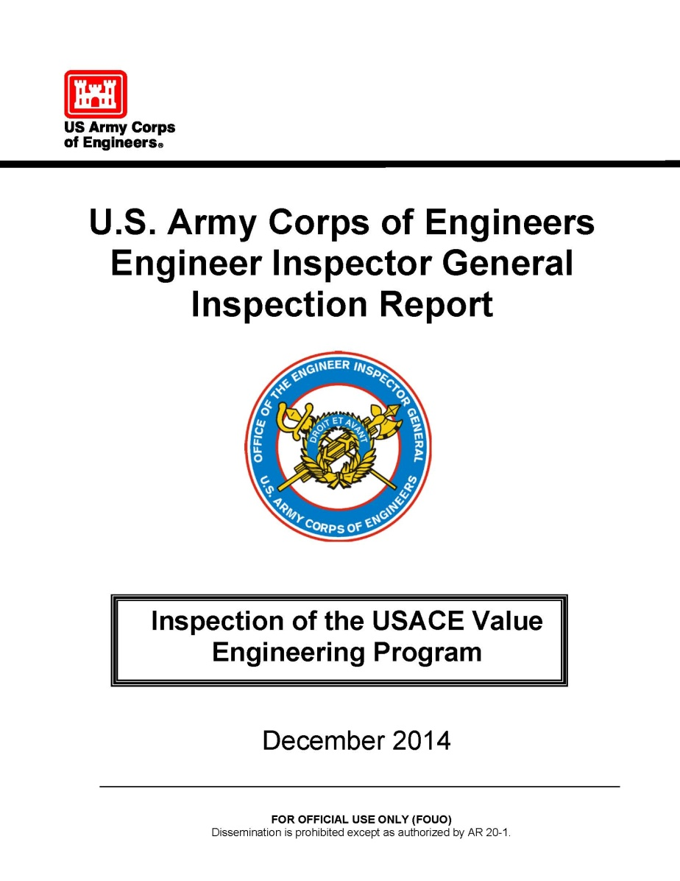
Value Engineering – EIG Report
EIG Report on Value Engineering was released in December with 12 recommendations – they include:
  Qualified, Trained, Dedicated VE staff
  Develop guidance, checklists, clarifications
  Higher visibility- DCGs, Commanders, Directors to be more involved
  Update Roles and Responsibilities
Metrics – I don’t trust the data, I don’t trust the rating
Slide Reported at the Last NWD RPRB

Slide 29
Value Engineering – EIG Report
USACE VALUE ENGINEERING PROGRAM
INSPECTION RECOMMENDATIONS
Commanders and Directors ensure the assigned VEO is an individual qualified and willing to perform the VE duties and functions outlined ER 11-1-321 Change 1.
DCG-CEO develop a training plan and program for the USACE Value Engineering Community of Practice.
Commanders and Directors ensure their commands complete all VE studies for projects that meet or exceed established VE dollar thresholds as required.
Commanders and Directors ensure that all command VE studies are led by a VE professional with the proper certification and completed in accordance with SAVE International® Methodology and standards as required.
Commanders and Directors ensure that VE requirements in the USACE PMBP Manual and ECB 2013-21 are a part of every project as required.
DCG direct the DCG-MIO and DCG-CEO to develop a standard VE checklist, to include scheduling and resourcing VE efforts, which PMs and PDTs will apply to each USACE project to ensure VE requirements are met.
Commanders and Directors ensure the MSC VE Program Manager position is staffed by a qualified individual with the primary duty of performing the VE functions outlined in ER 11-1-321 Change 1.
DCG direct the DCG-MIO and DCG-CEO to revise VE specific guidance, policies and manuals to clarify and update VE roles, responsibilities and requirements.
DCG direct revisions and updates to USAGE policy and guidance to clarify VE roles, responsibilities and requirements across all mission areas.
DCG direct the DCG-MIO and DCG-CEO to meet with supported agencies, departments and commands to clarify VE requirements and responsibilities when USACE is the contract executing authority for their projects.
DCG direct the DCG-MIO and DCG-CEO to evaluate and validate VE metrics and measures to ensure VE performance is accurately assessed and captured at USAGE commands.
Commanders and Directors consider including VE performance and metrics in Command Management Reviews.
Slide Reported at the Last NWD RPRB

Slide 30
Value Engineering – EIG Report
USACE VALUE ENGINEERING PROGRAM
INSPECTION RECOMMENDATIONS
Commanders and Directors ensure the assigned VEO is an individual qualified and willing to perform the VE duties and functions outlined ER 11-1-321 Change 1.
DCG-CEO develop a training plan and program for the USACE Value Engineering Community of Practice.
Commanders and Directors ensure their commands complete all VE studies for projects that meet or exceed established VE dollar thresholds as required.
Commanders and Directors ensure that all command VE studies are led by a VE professional with the proper certification and completed in accordance with SAVE International® Methodology and standards as required.
Commanders and Directors ensure that VE requirements in the USACE PMBP Manual and ECB 2013-21 are a part of every project as required.
DCG direct the DCG-MIO and DCG-CEO to develop a standard VE checklist, to include scheduling and resourcing VE efforts, which PMs and PDTs will apply to each USACE project to ensure VE requirements are met.
Commanders and Directors ensure the MSC VE Program Manager position is staffed by a qualified individual with the primary duty of performing the VE functions outlined in ER 11-1-321 Change 1.
DCG direct the DCG-MIO and DCG-CEO to revise VE specific guidance, policies and manuals to clarify and update VE roles, responsibilities and requirements.
DCG direct revisions and updates to USAGE policy and guidance to clarify VE roles, responsibilities and requirements across all mission areas.
DCG direct the DCG-MIO and DCG-CEO to meet with supported agencies, departments and commands to clarify VE requirements and responsibilities when USACE is the contract executing authority for their projects.
DCG direct the DCG-MIO and DCG-CEO to evaluate and validate VE metrics and measures to ensure VE performance is accurately assessed and captured at USAGE commands.
Commanders and Directors consider including VE performance and metrics in Command Management Reviews.
How do we comply with the EIG Report if the Data is Suspect?
VEO’s QC the Data
Slide Reported at the Last NWD RPRB

Slide 31
QA/QC the Data
VE - Program Coverage Annual
  A project is counted in the query when “ML290(S)” is added from the generic template regardless of the need for a VE. For the purposes of this discussion, the data that will be analyzed is:
    NWD-All (CW & MP)
    Data Set Analyzed: Program Coverage-Annual given it has the most line items to QC. Analysis will help both Coverage and Compliance.
    Data Date: 7-Jan-15
    All Project Active in P2 (Not closed, inactive canceled, etc)
  Focus on:
    Program Year (Column S)
    Contract Amount/Resourced in P2 (Column G)
    Program Amount (Column I)
    Contract Award (Column G)
    VE Start (S/A): Summary of EN139, CW285, or ML285 (Columns AR & AS)
    VE End (S/A): Summary of EN140, CW290, and ML290 (Column (AP & AO)
    Waiver Date (Column AT), and
    Low Opportunity Date (Column AQ)
  Will not focus on:
    Authorization Phase
    Customer Number
    Other Milestones
Project Data Provided in Backup

Slide 32
QA/QC the Data
Sample Results:
  VE Complete: Flag all projects where VE End (A), Low Opp or Waiver Complete
  VE Milestones: Verify if VE Start = VE Finish. Could mean milestones were added but not updated or not needed.
  Contract Amount: Flag resourced amounts greater than $2.0M and verify milestones and Low Opportunity or Waiver dates. Contract Amounts are zero due to:
    Line-item has not been resources or
    Line-Items resourced in a future year
  Program Amount: Flag PAs greater than $2.0M and verify milestones and Low Opportunity or Waiver dates. These may not be resourced yet.
  Program Year: Verify PY which is too far in the past or too far ahead in the future to see if projects are valid. Usually these projects are inactive and have not been closed in P2.
  Award: Verify if cc800 Award equals “blank.” Could mean a full template was used for tasks outside of project execution.
PY Blank = 21 | PY 2014 = 47
PY 2008 = 1 | PY 2015 = 18
PY 2010 = 2 | PY 2016 = 2
PY 2012 = 3 | PY LR (Long Range) = 4⁽¹⁾
PY 2013 = 3
(1) VE Query should not pull Long Range Projects

Slide 33
QA/QC the Data
Summary of Findings:

Slide 34
QA/QC the Data
Other Resources for General Project Info: located at: https://pmbp.usace.army.mil/portal/pls/portal/pmbp.cmi.home
The lack of P2 data outside of MILCON (i.e., SRM), makes VE hard to determine such as PA’s being blank.
VEOs need to monitor what is resourced in P2 and the Program Amount
VEO’s need to verify (based on low project numbers) does the P2 templates outside of MILCON have the VE Milestones
  PMs do not QC most data outside of (1) design reviews, (2) when project is ready to advertise, (3) award (cc800), or (4) project closeout.

Slide 35
Best Business Practices
PRB Monitoring. Need to look at all sources for information regarding what projects should be in your VE Management Plan.
Keep Two Set Of Books:
  Your set which is the master for QA/QC purposes
  What is reported in P2
Track the ceiling amount for the data line item. MILCON calls the field Program Amount. All other Mission Areas may or may not include it in P2.
Data Quality:
  Perform periodic P2 vs. your set of books data quality check of projects
  Work with the Mission Area Chiefs and their P2 schedulers
Become a Value Engineering Data Program Manager and not just a VE Officer. This will assist you in getting project data corrected, copies of the PRB, and out year project lists.
Understand How Your District Updates P2 (everybody is different)
Report VE at your District PRB.
Notes:
PRB Monitoring (180 days and Beyond): Even though the metric is from 365 days and beyond, District’s should monitor projects with durations 180 days and beyond.
QC of District Data: Periodic QC of P2/ Construction Data.
Contracts vs. Projects: Identify what is reportable.
Institutionalize the use of the BOD ECB.
Analyze Trends: Periodically analyze delays to see if there is preventative and/or corrective actions that need to be pursued locally or nationally.
CCG/EBP Refresher Training: Periodically, based on District performance, verify if additional training is needed regarding the CCG or EBP.
Assigning a Project Closeout Project Manager.
Closely monitor and assign Acceptable Delay Codes.
35

Slide 36
…and now for a live view of the EDW…

Slide 37
Backup

Slide 38
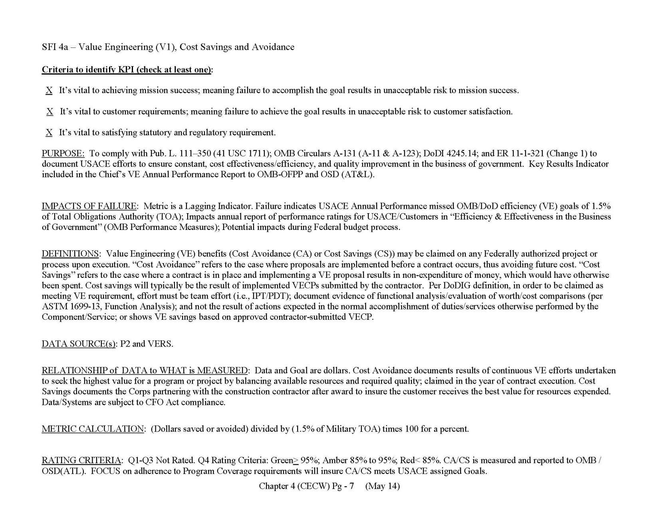
SFI 4a: Value Engineering (V1),
Cost Savings And Avoidance

Slide 39
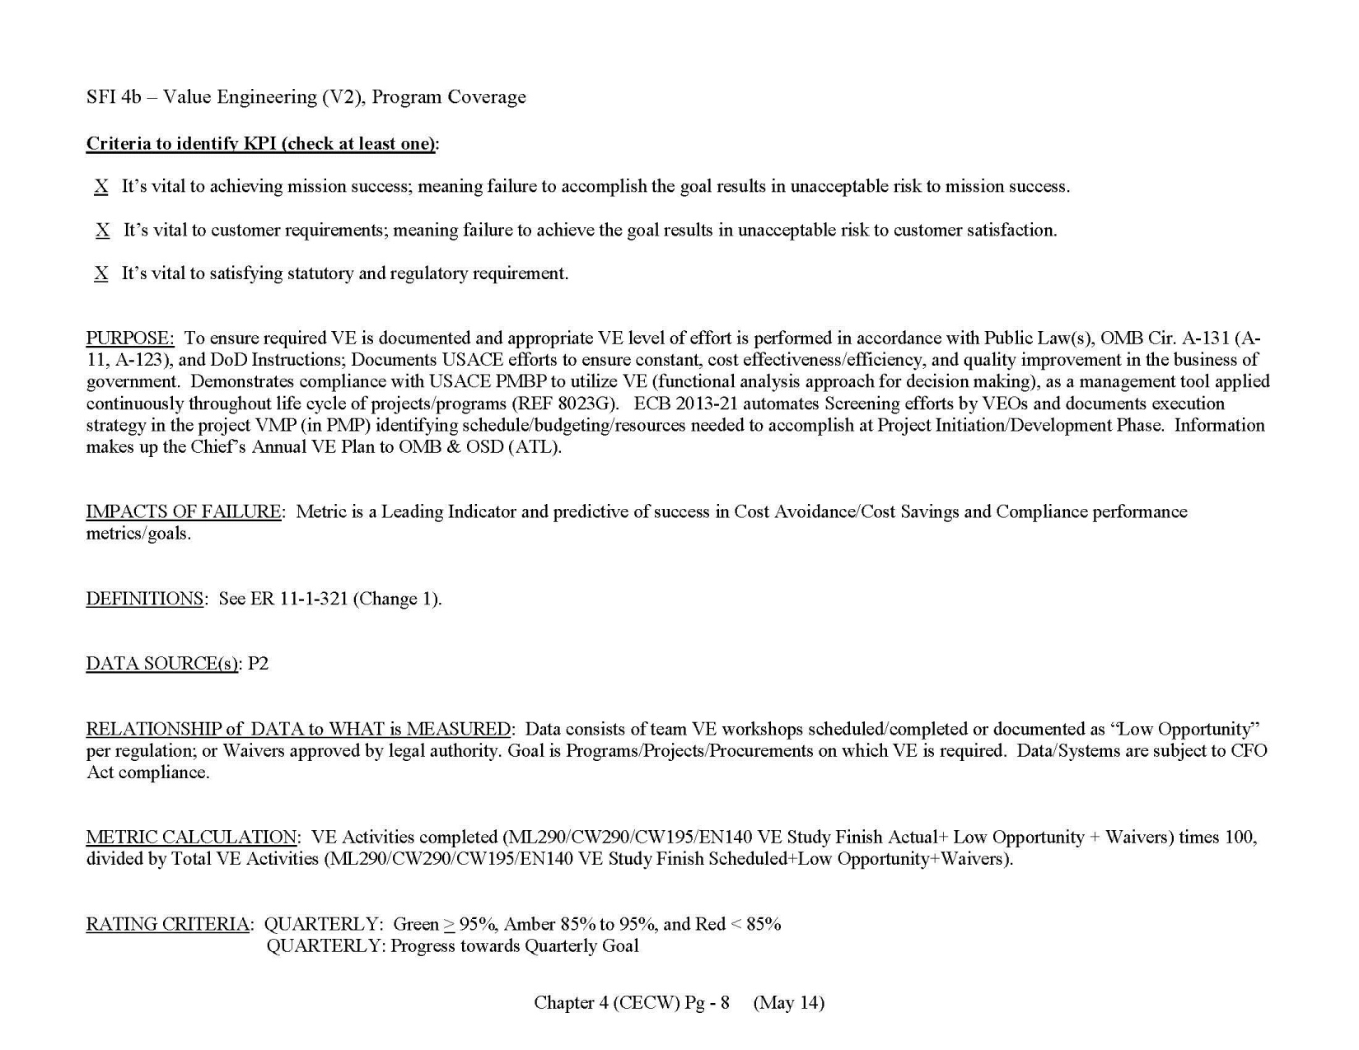
SFI 4b: Value Engineering (V2),
Program Coverage

Slide 40
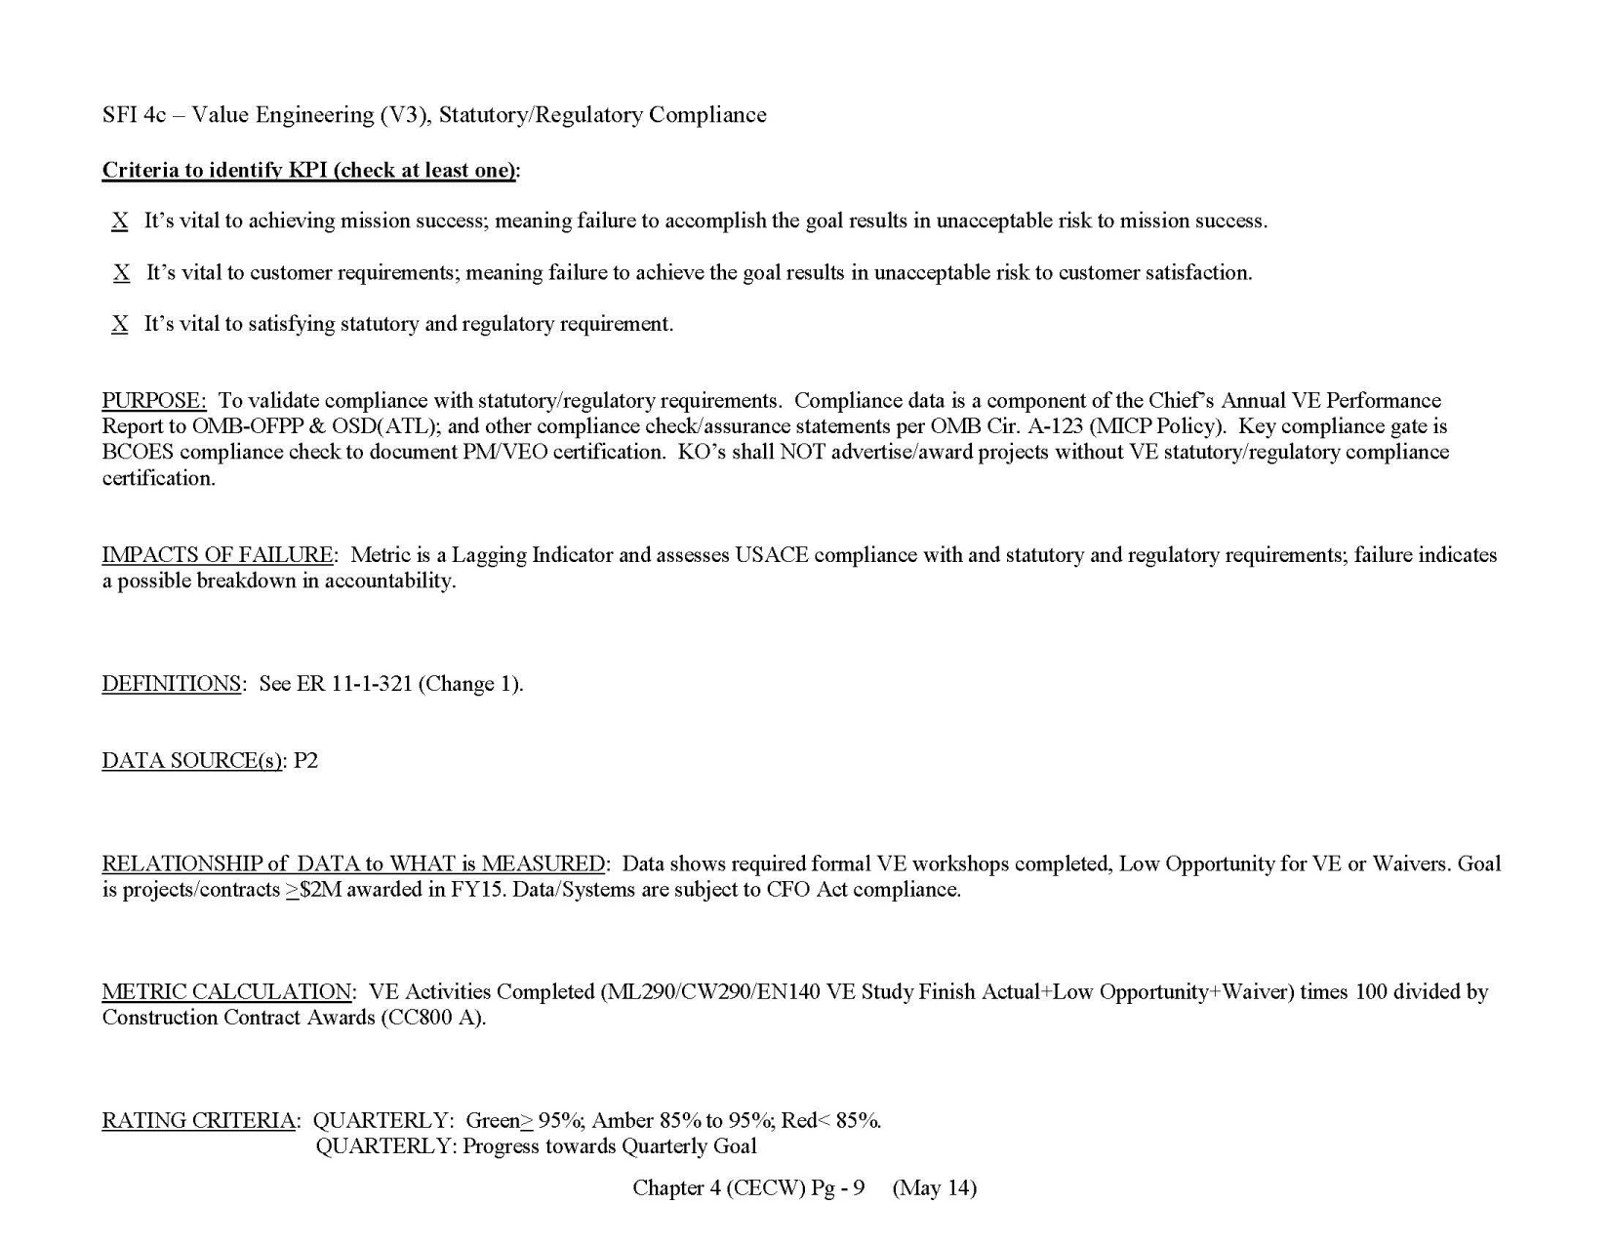
SFI 4c: Value Engineering (V3),
Statutory/Regulatory Compliance

Slide 41
MP16: Value Engineering,
Cost Savings And Avoidance

Slide 42

MP17: Value Engineering,
Program Coverage

Slide 43

MP17a: Value Engineering,
Statutory/Regulatory Compliance

Slide 44
CW08: Value Engineering,
Cost Savings and Avoidance

Slide 45
CW08a: Value Engineering,
Program Coverage

Slide 46
CW08b: Value Engineering,
Statutory/Regulatory Compliance

Slide 47
Data Backup – NWK
CA or PA > $2.0M or VE Date P
Verify Data Point

Slide 48
Data Backup – NWO
CA or PA > $2.0M or VE Date P
Verify Data Point

Slide 49
Data Backup – NWO
CA or PA > $2.0M or VE Date P
Verify Data Point

Slide 50
Data Backup – NWO
CA or PA > $2.0M or VE Date P
Verify Data Point

Slide 51
Data Backup – NWO & NWP
CA or PA > $2.0M or VE Date P
Verify Data Point

Slide 52
Data Backup – NWS & NWW
CA or PA > $2.0M or VE Date P
Verify Data Point

Slide 53
FAQs - Cost Avoidance/Savings Dashboard
Why does my cost avoidance/savings VERS data entry not appear in VE Dashboard CACS?
  P2#s must be in P2 – not just an entry in VERS. P2#s are always six numeric digits. P2#s just for VERS entry but not in P2 examples (00000, 11111, Letters).
  VERS entry MUST include a VE Study #. VE Study Number is now identified as Required in VERS. Dashboards require study #s to insure studies are matched with specific contracts. VERS entries without study #s will not appear in dashboards.
  Dashboards will display VERS entries in the district that owns the P2#. Dashboards do not care who submitted the entry in VERS.
  Entries’ fund type (CW or MP) will be determined by P2 (Program) not VEO entry.
  Dashboards use the VERS report dates for CA/CS. If CA/CS date is in Q4, it will not appear in Q1, Q2 or Q3.
How frequent are uploads from VERS to Dashboards?
  Data date from VERS to Dashboards has a two day lag.
  Day 1: data is transferred from VERS to a location that HQ can access (nightly).
  Day 2: data is transferred from HQ to EDW Local Data Portal
  Day 3: data is reflected in Dashboard

